Slide 1
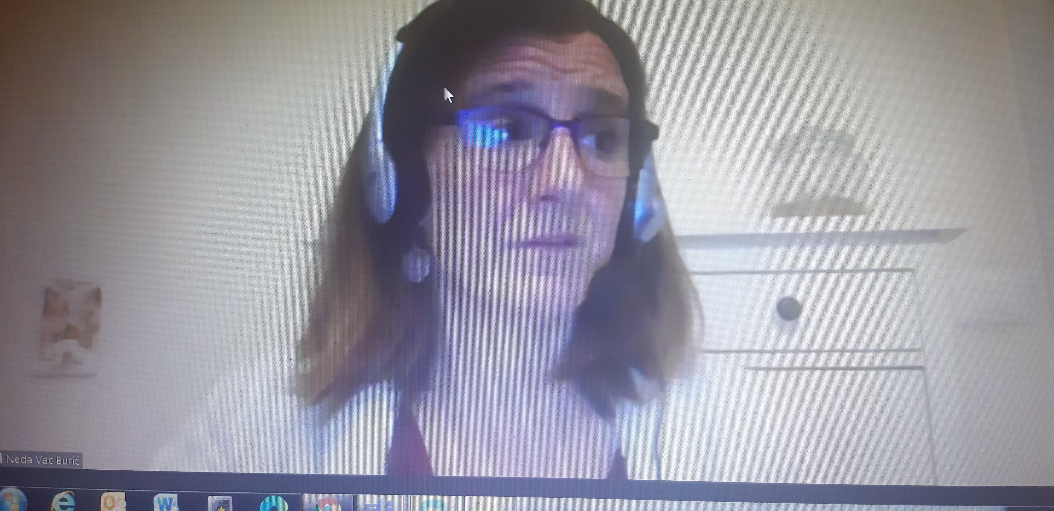
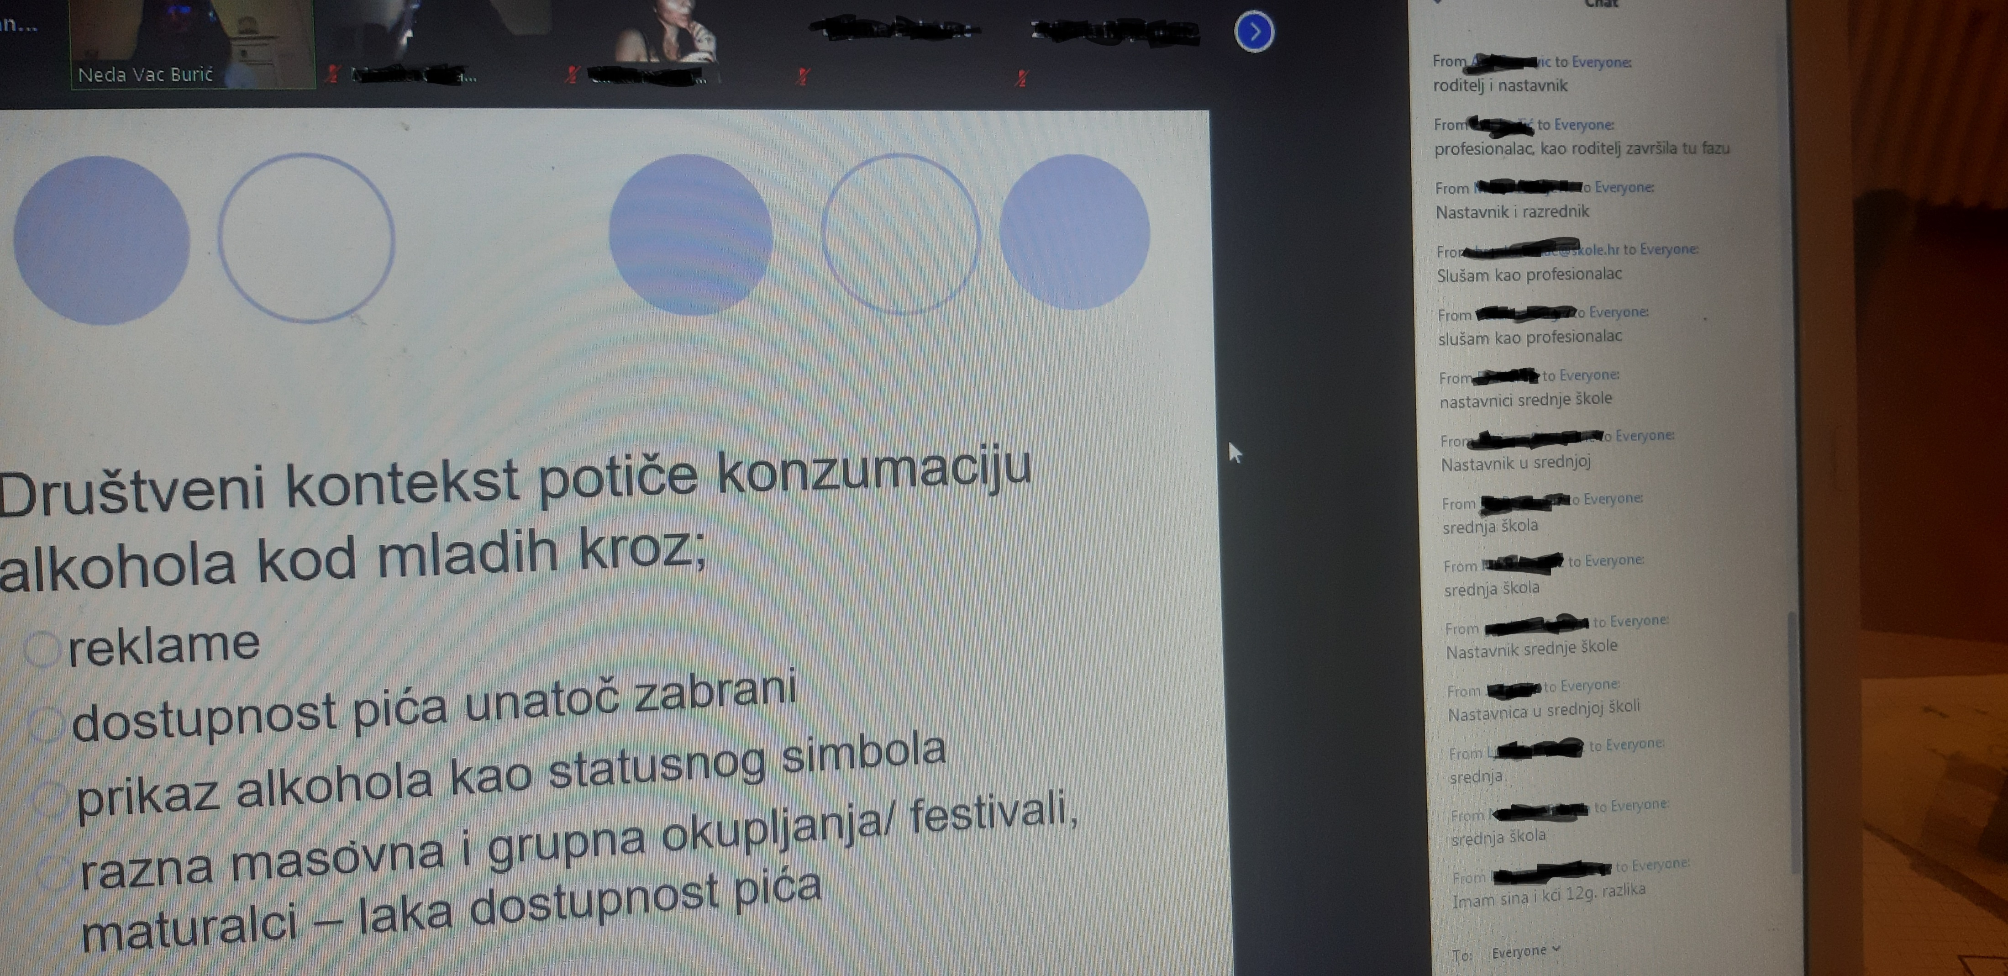
Familylab Croatia – educational lectures Experiment time as a part of the project More dialogue, less risk behaviours
11.12.2020., from 18.00 till 20.00h in cooperation with NGO Klupko from Vinkovci.

Slide 2
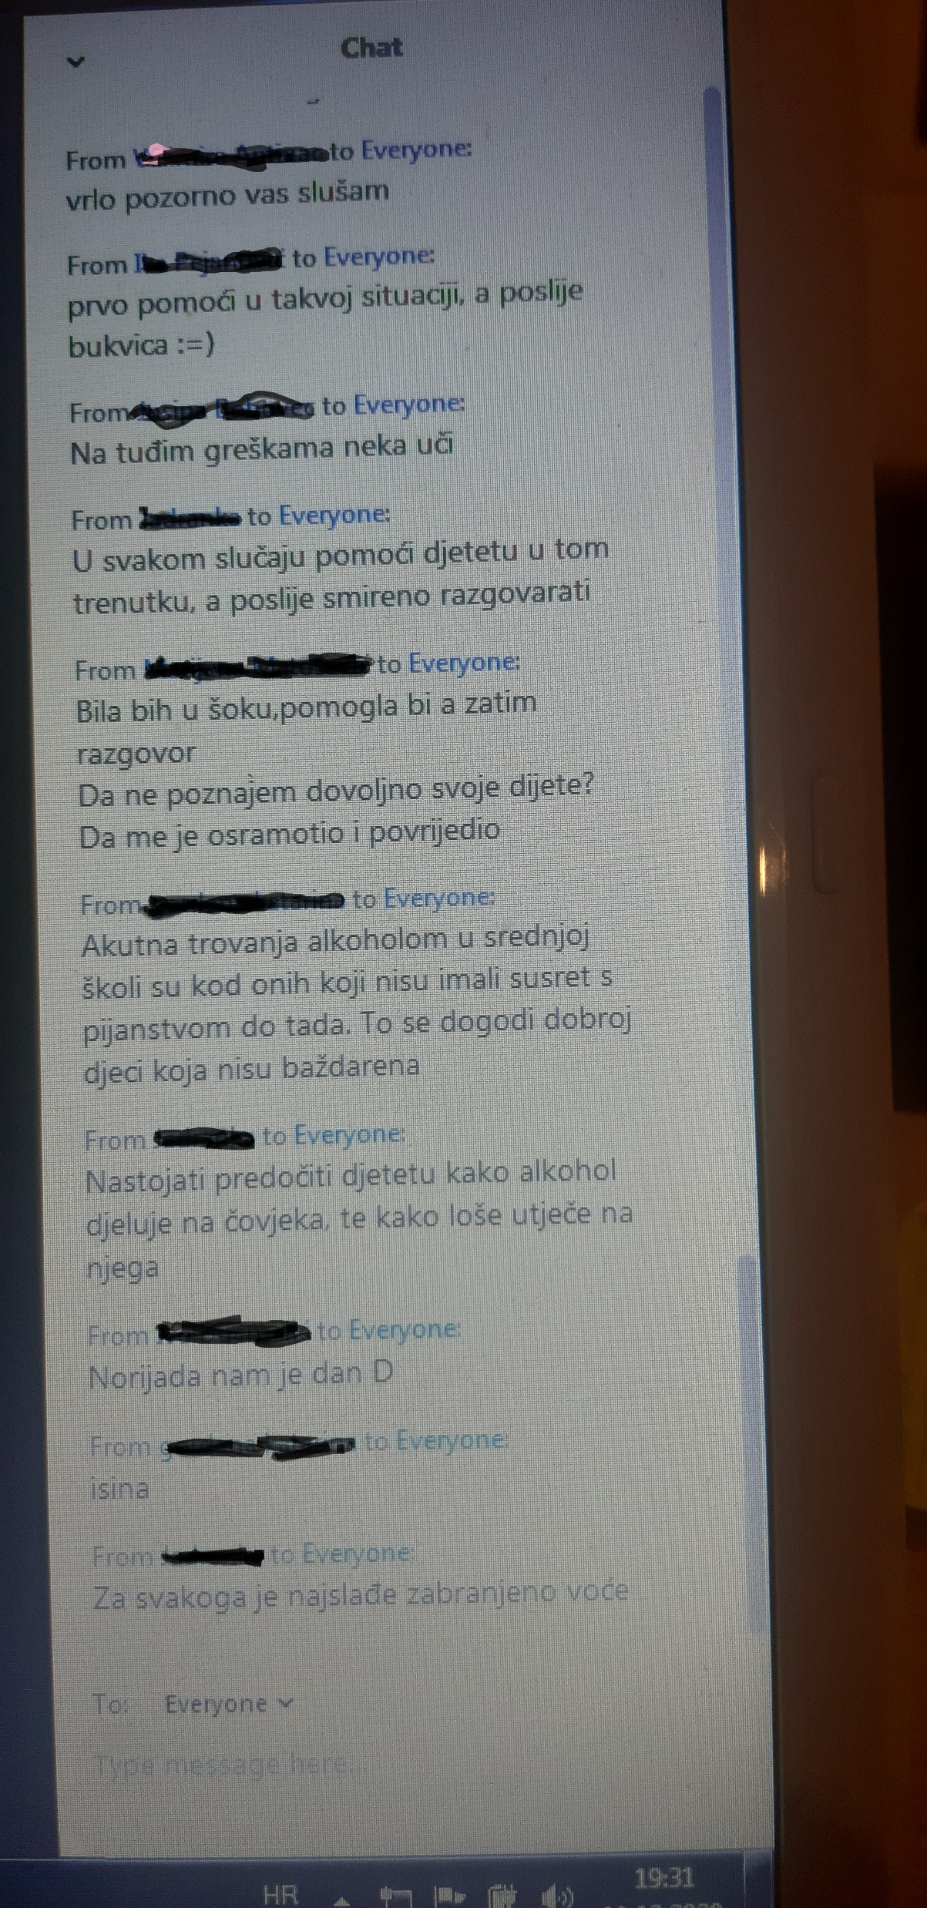
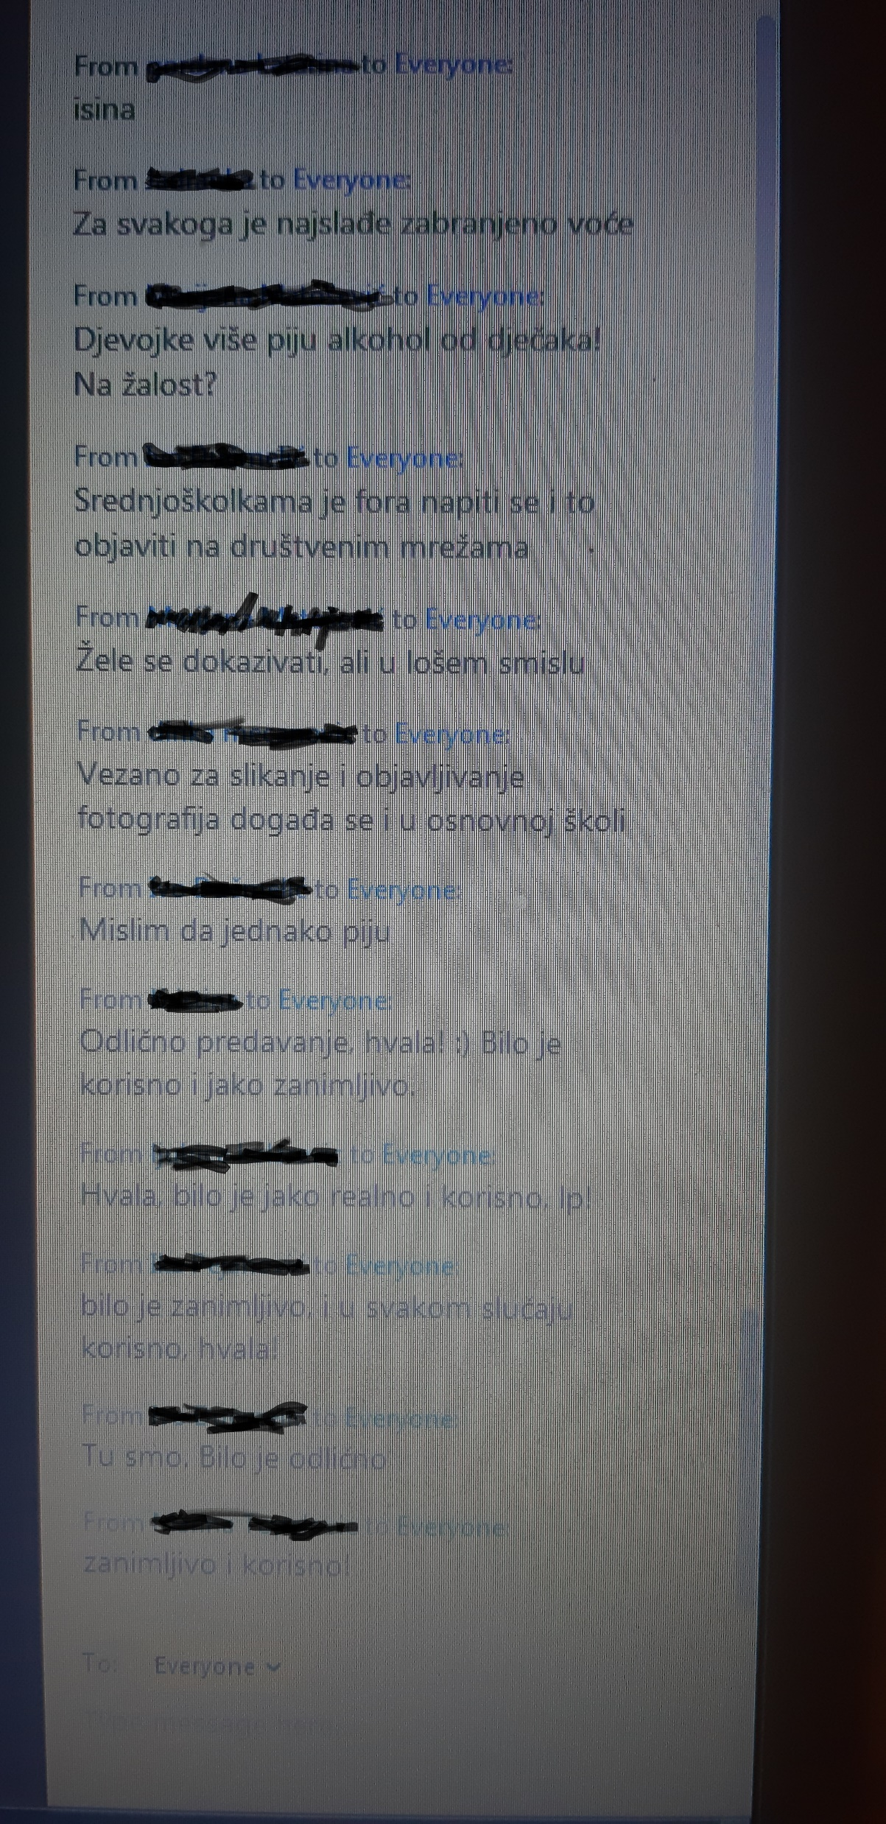
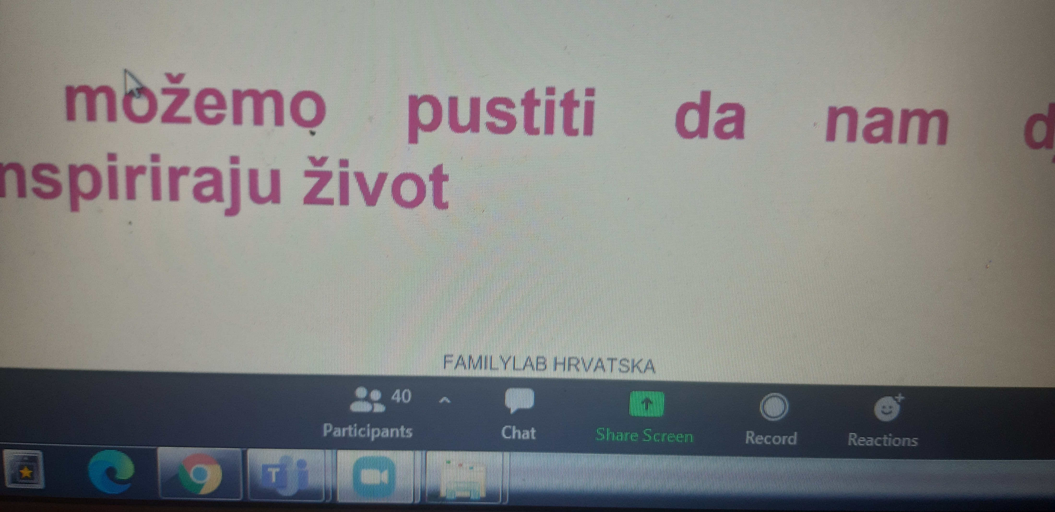
Familylab Croatia – educational lectures Experiment time as a part of the project More dialogue, less risk behaviours
11.12.2020., from 18.00 till 20.00h in cooperation with NGO Klupko from Vinkovci.
NUMBER OF PARTICIPANTS

Slide 3
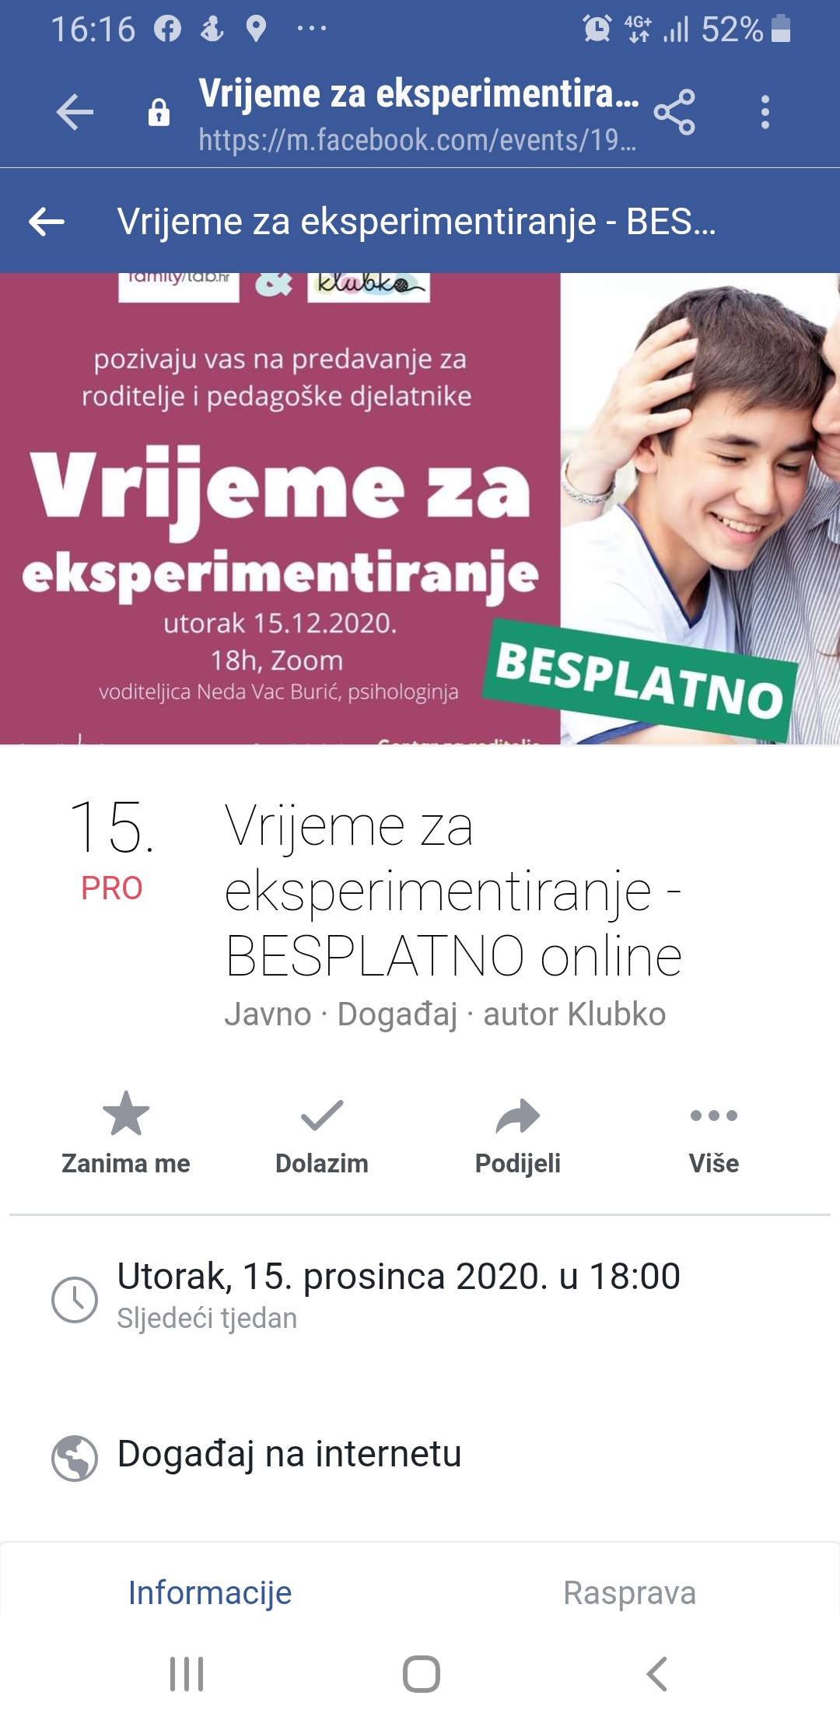
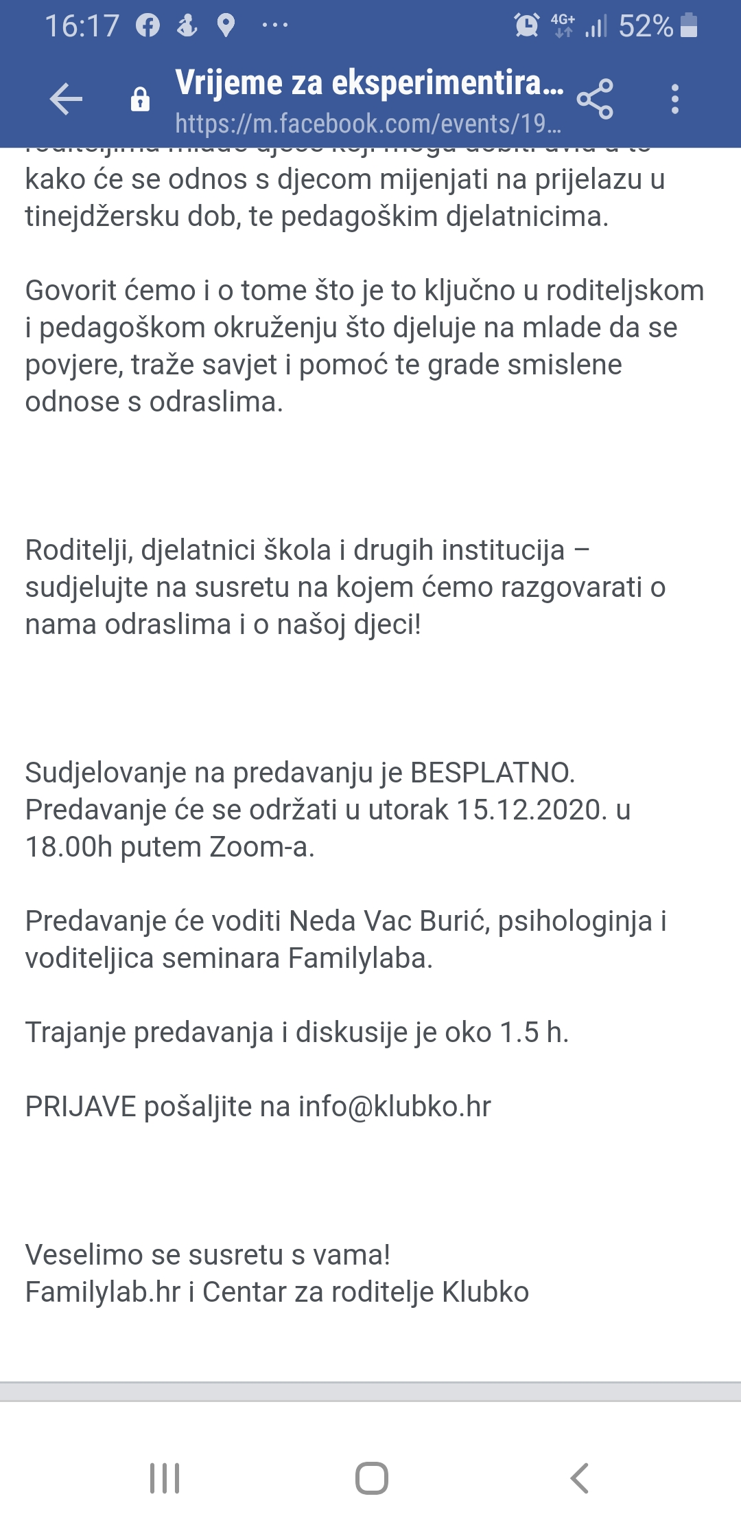
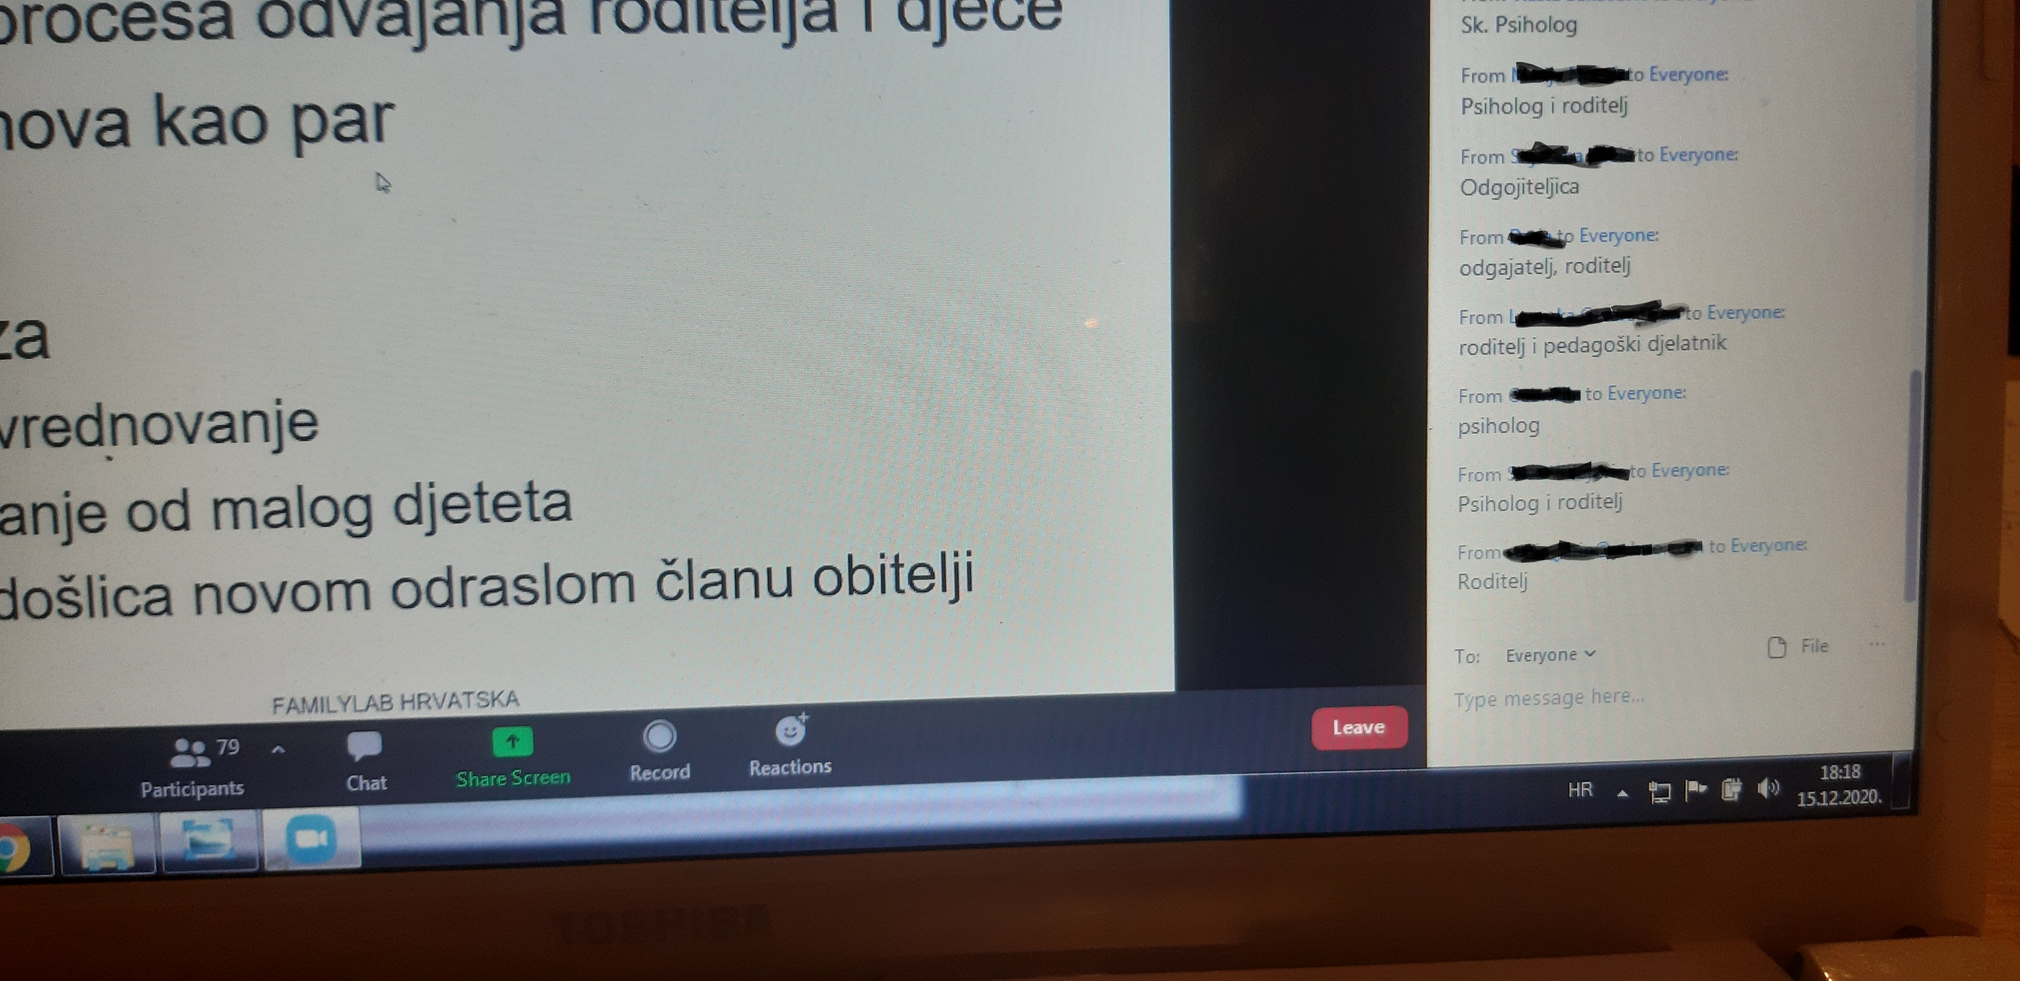
Familylab Croatia – educational lectures Experiment time as a part of the project More dialogue, less risk behaviours
15.12.2020., from 18.00 – 20.00 h in cooperation with NGO Klubko from Zagreb.
NUMBER OF PARTICIPANTS

