Slide 1
EVALUATION OF
RD AMONG STUDENTS PROGRAM
HOW MUCH AND HOW MANY?
2023-2024 academic year
Bulgaria
spiritsBULGARIA June 22, 2024
Sofia, 40-Bratia Bakston Str.

Slide 2
SECOND YEAR OF RD PROGRAM “HOW MUCH AND HOW MANY?” EXECUTION
2nd year of execution
3 seminars in 3 universities with 254 attendants
3 months for creative concepts development
17 applications
9 jury members
1 awarding ceremony
6 awards
29 future RD ambassadors

Slide 3



PROGRAM PARTNERS
New Bulgarian University (NBU)
  Well established partner from LY 2022-2023
  https://www.nbu.bg/en/
National Art Academy
  New partner 2023-2024
  https://nha.bg/en
University for National and World Economic
  New Partner 2023-2024
  https://www.unwe.bg/
Timing was based on academic year Sep 2023 – Jun 2024, and our University partners’ preference to execute the program in the Spring students’ semester
Note: The program concept was sponsored by spiritsEUROPE with a call for application 2023

Slide 4
PROGRAM GOALS
Build on the pilot phase of the program and establish it as an annual initiative
Raise awareness among students about responsible alcohol consumption among adults
Increase resistance to peer pressure
Reduce harmful habits, including excessive, illegal, and dangerous alcohol use
Promote the importance of not driving after alcohol consumption
Enhance communication efforts within the students’ community

Slide 5
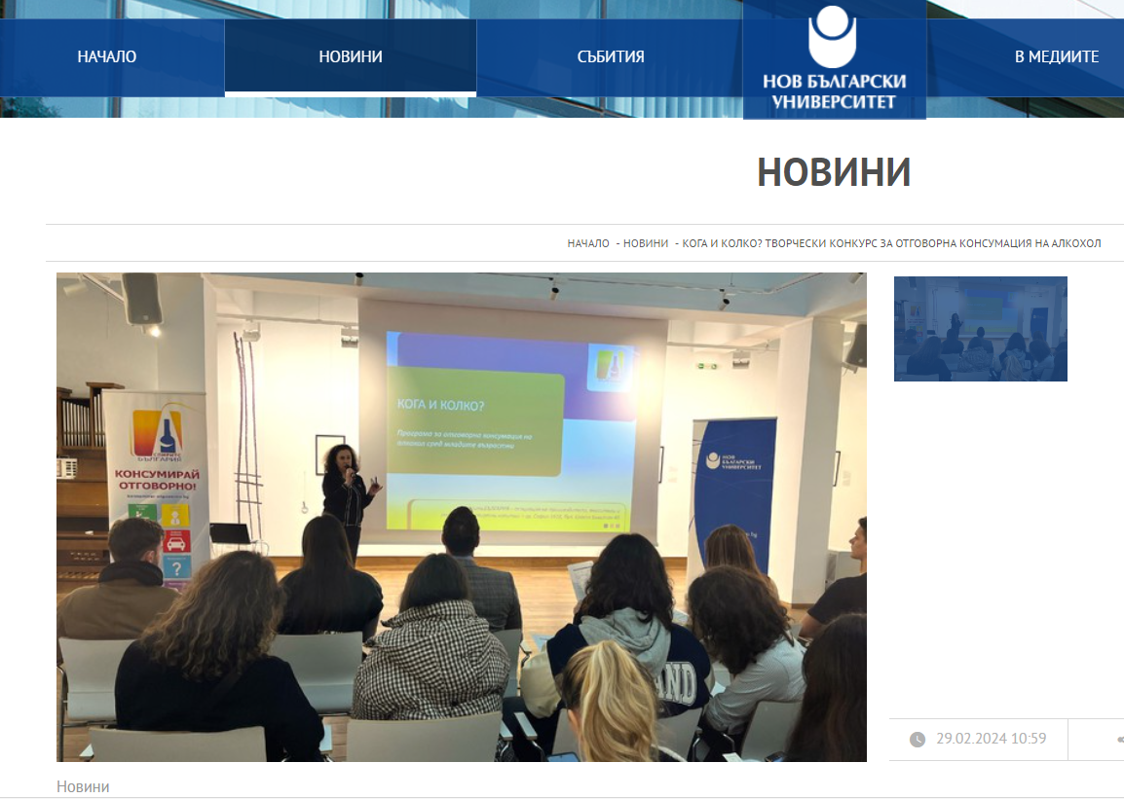
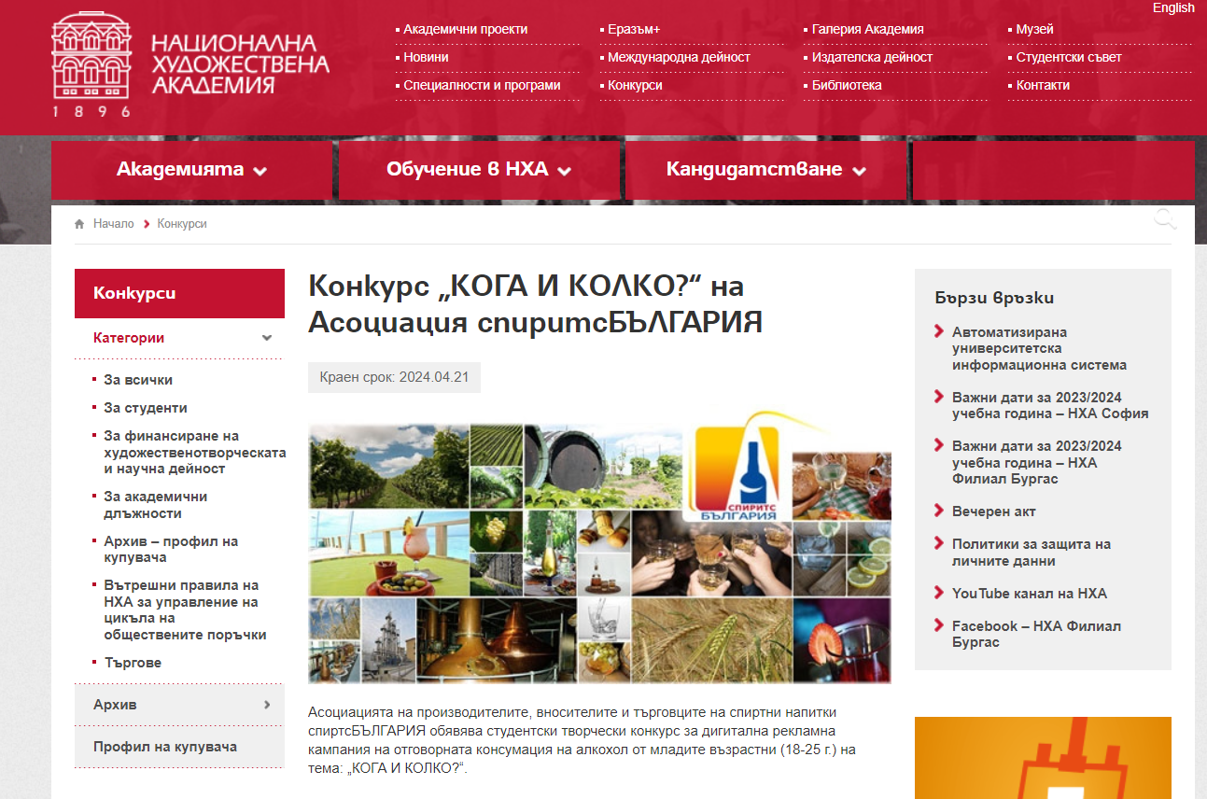
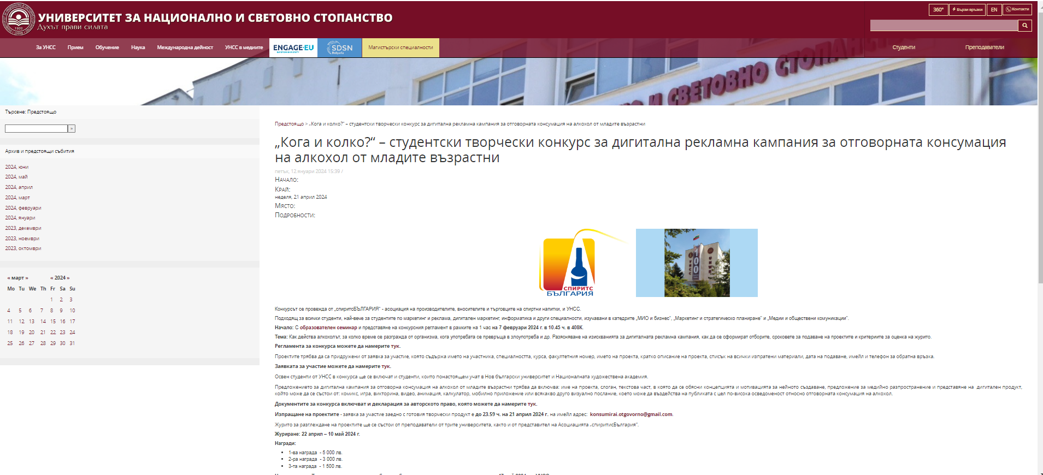
SEMINARS ANNOUNCEMENT
Publications in the three partner universities communicational platforms

Slide 6
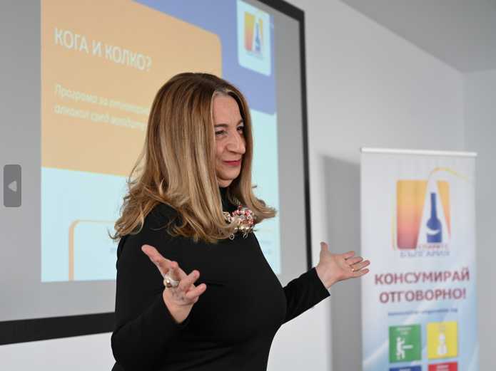
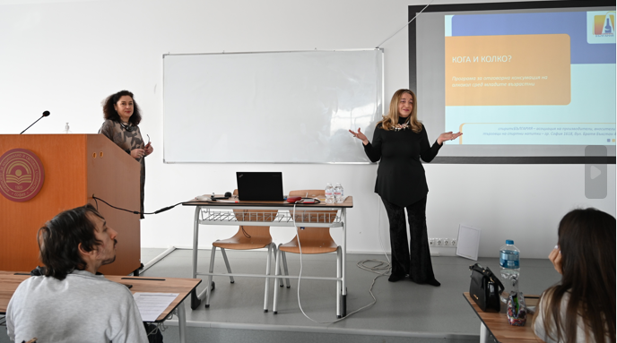
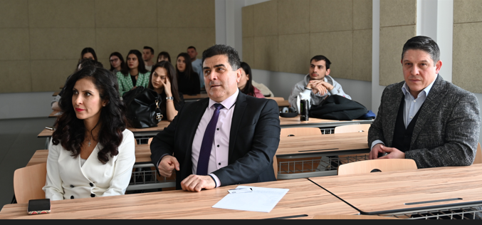
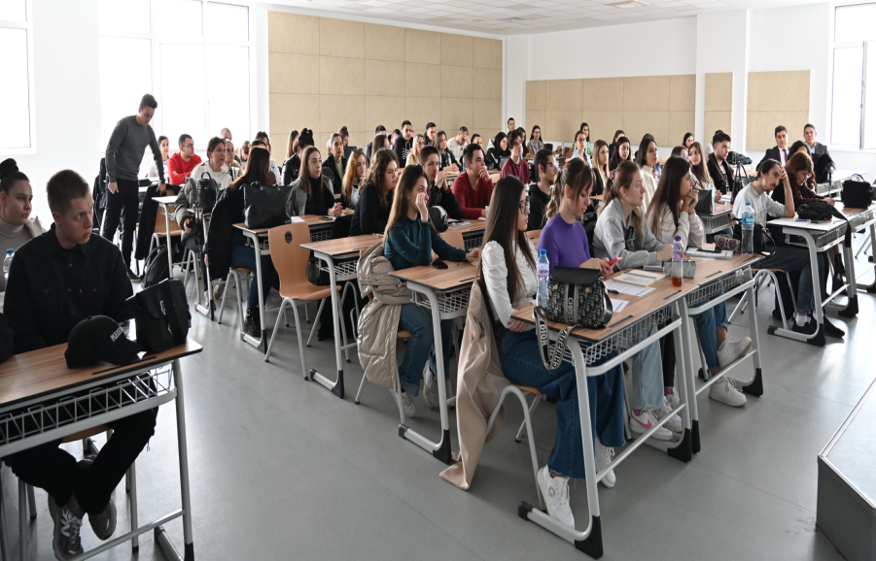
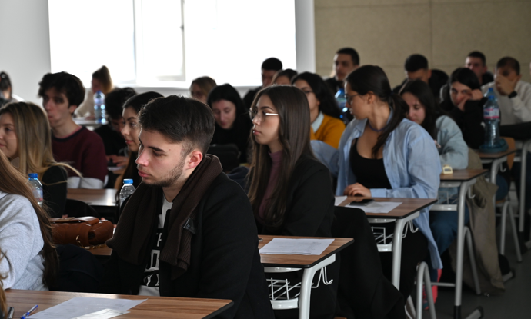
SEMINARS 2024
RD seminar at UNWE, 2 February 2024
94 attendees

Slide 7
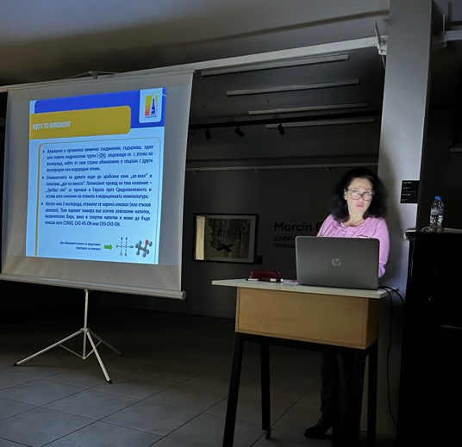
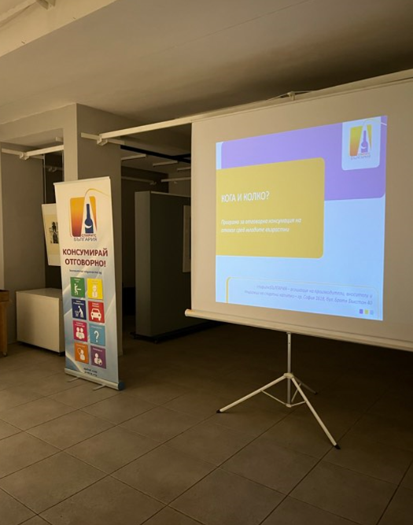
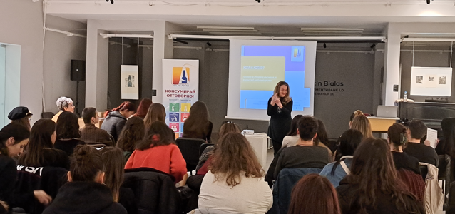
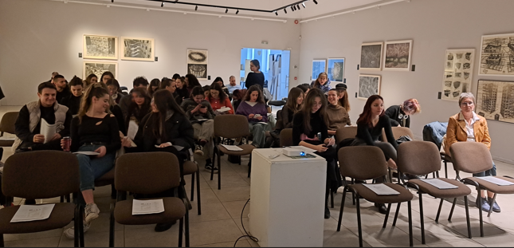
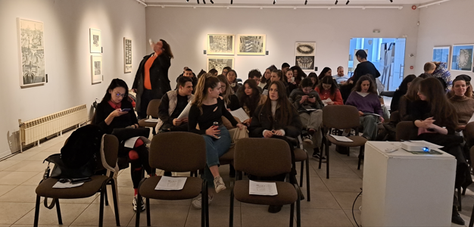
SEMINARS 2024
RD seminar at NAA, 14 February 14 2024
62 attendees

Slide 8
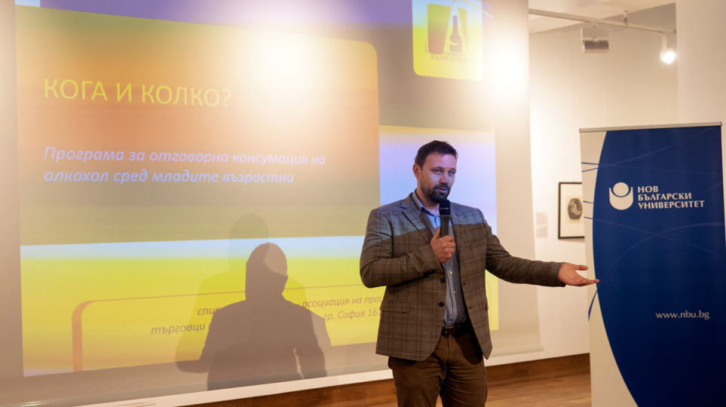
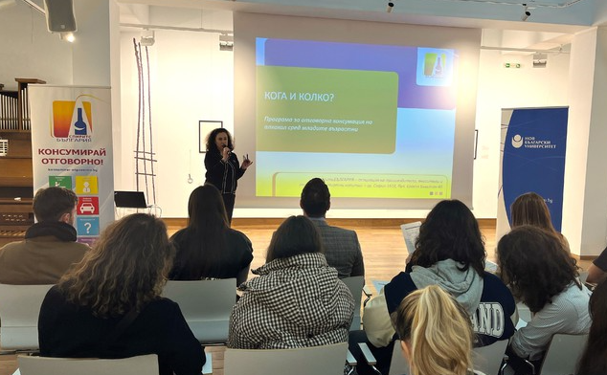
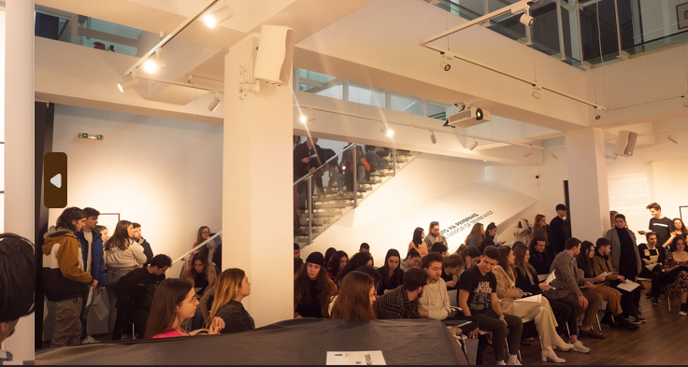
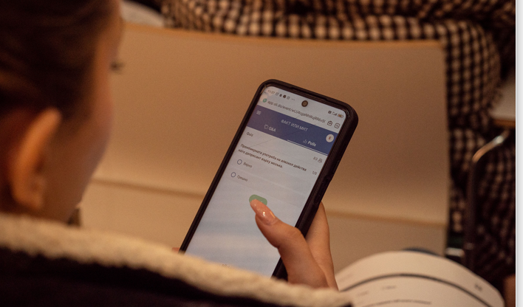
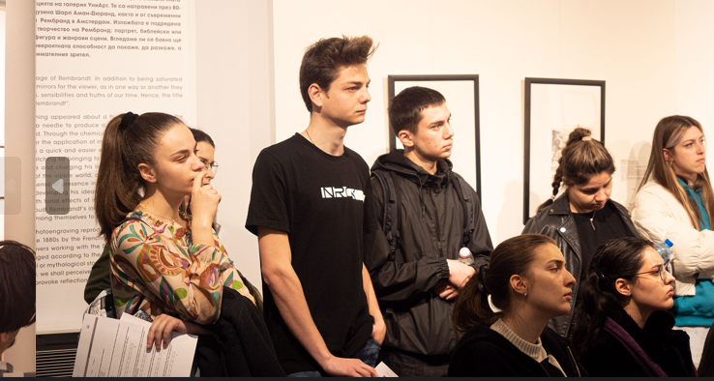
SEMINARS 2024
RD seminar at NBU, 28 February 2024
98 attendees

Slide 9
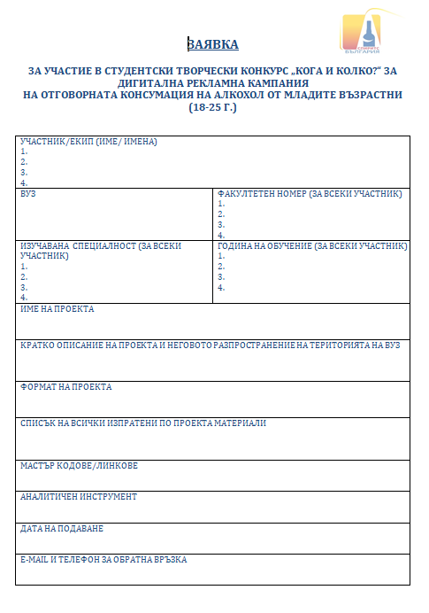
PROGRAM ACHIEVEMENTS – APPLICATION form
The application form
New elements in both Application form and participation Rules
The assignment: Creative contest for digital advertising campaign of RD among students (18-25 YO)
Focus on digital format
Task for a RD slogan/call for action
Requirement for available analytical instrument for every project
Request for a fuller description of the project
Students faculty identification number

Slide 10
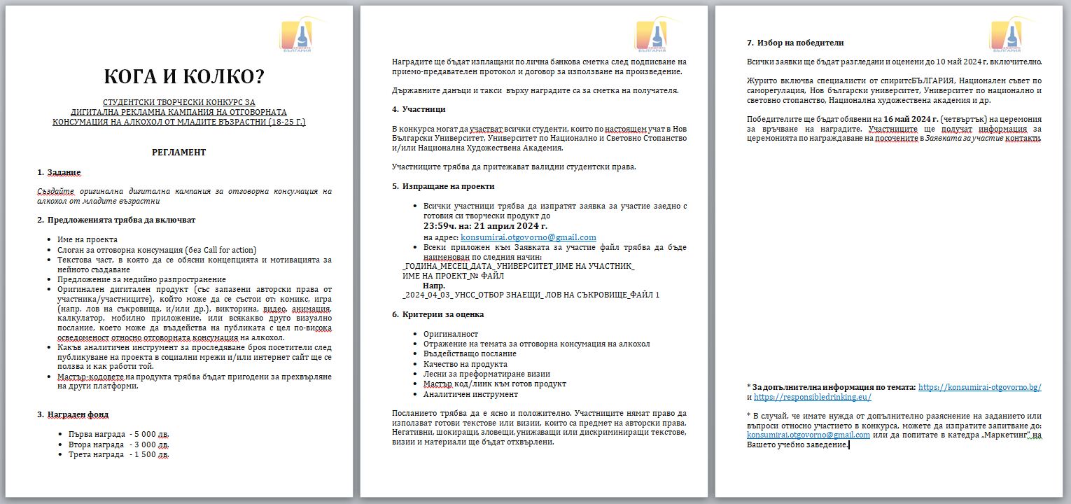
PROGRAM ACHIEVEMENTS – APPLICATION & RULES
The participation Rules

Slide 11
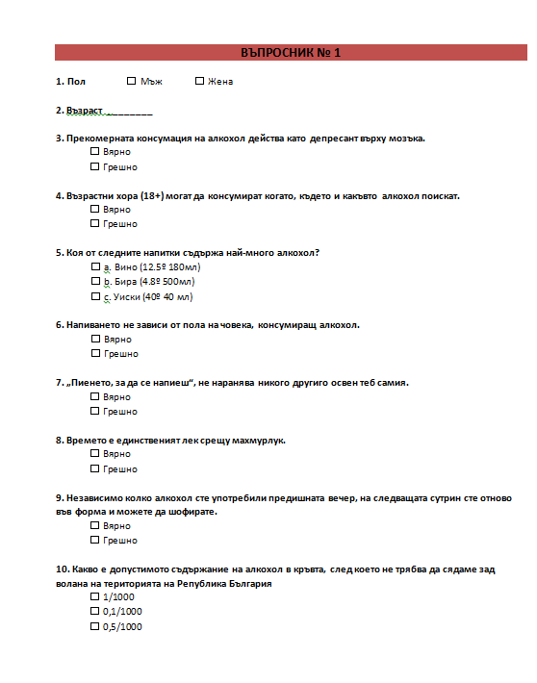
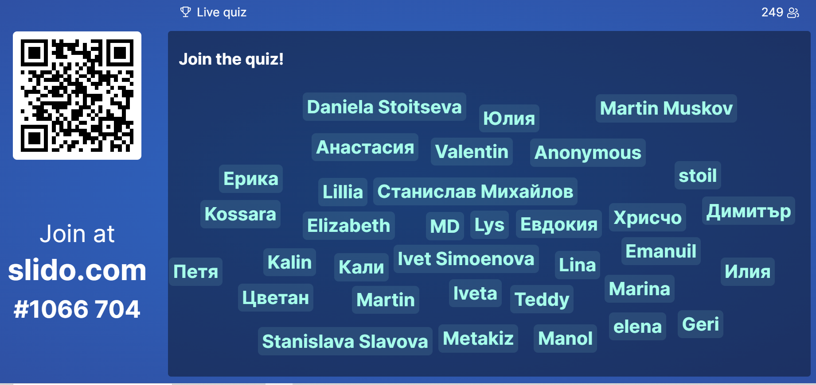
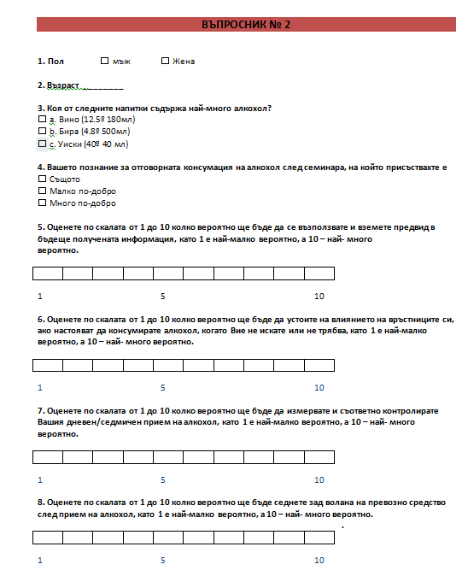
PROGRAM ACHIEVEMENTS – THE STUDY
TWO questionnaires – pre- and post- Seminar
10 and 8 questions have assessed students' knowledge and attitudes towards the topic
249 students (out of 254 attendees) provided their answers to the study both online and on paper
The questionnairs

Slide 12
PROGRAM ACHIEVEMENTS – THE STUDY (WELL-KNOWN TRUTHS)
Q3: Excessive alcohol consumption acts as a brain depressant
Q4: Adults (18+) can consume alcohol whenever they want
Q7: No matter how much alcohol you consumed the night before, the next morning you are fit and ready to drive again
Q5: Getting drunk does not depend on the gender

Slide 13
PROGRAM ACHIEVEMENTS – THE STUDY (STATEMENTS TO IMPROVE)
Q5: Which of the following drinks contains the most alcohol?
Q7: "Drinking to get drunk" doesn't hurt anyone but you
Q8: Time is the only cure for a hangover
No dramatic changes vs. 2023. 100% of respondents gave correct answers to all of the above questions after the end of the seminars.

Slide 14

PROGRAM ACHIEVEMENTS – THE STUDY (SCALE RATINGS)
Q5: Rate on a scale of 1 to 10 how likely you are to benefit and take the information you receive into account,
with 1 being the least likely and 10 being the most likely.
2
3
4
6
9
5
220
Q6: Rate on a scale of 1-10 how likely you are to resist peer pressure to consume alcohol when you don't want to
or shouldn't, with 1 being the least likely and 10 being the most likely
3
4
1
2
3
5
10
7
214
Figures in cells above are number of people giving the rate for this score at the scale
These who rated bellow 5 (question 5 and 6) do not or hardly ever drink alcohol

Slide 15
PROGRAM ACHIEVEMENTS – THE STUDY
(SCALE RATINGS Cont’d)
Q7: Rate on a scale of 1-10 how likely you would be to measure and control your daily/weekly alcohol intake accordingly,
with 1 being the least likely and 10 being the most likely
1
4
5
8
7
224
Q8: Rate on a scale of 1-10 how likely you are to drive after consuming alcohol,
with 1 being the least likely and 10 being the most likely
243
3
3
Figures in cells are number of people giving their rate for this score at the scale
These who rated bellow 5 (question 7) do not or hardly ever drink alcohol

Slide 16
PROGRAM ACHIEVEMENTS – THE SELECTION & JURY
17 projects applied
  9 from NBU
  5 from UNWE
  3 from NAA
Jury voted online independently in 7 days after closing of contest
Jury 9 members:
  Assoc. Prof. Kalina Hristova – NBU
  Assoc. Prof. Borislava Stoimenova – UNWE
  Assoc. Prof. Georgi Pavlov – NAA
  Alisa Gjuzeleva – The contest winner in 2023
  Eli Gerganova – Chairman of National Council for Self-Regulation
  Iva Mihova-Mitrovska – Board Member of spiritsBULGARIA, Head of Regulatory Affairs and Public Communications at Coca-Cola HBC Bulgaria
  Ralica Scorcheva-Slavova – Chairman of spiritsBULGARIA and Manager of Maxxium Bulgaria
  Gergana Gevezova-Koleva – Executive Secretary spiritsBULGARIA
  Adriana Momchilova – CSR manager Pernod-Ricard Bulgaria
Projects were evaluated on a scale of 1 to 10 according to preliminary announced participation Rules criteria

Slide 17
PROGRAM ACHIEVEMENTS – WINNERS AND AWARDS
The Award event took place in the Ceremony Hall of UNWE
Audience – contest participants and friends, tutors, jury members and organization team
Awards
Project 17 – SCREENSHOT - 1st place - award of 5 000 BGN (p. 34)
Project 12 – WHAT WILL YOU DRINK - 2nd place - award of 3 000 BGN (p. 29)
Project 14 – KEEP THE MOMENT - 3rd place - award of 1 500 BGN (p. 31)
Project 10 – REACTION TIME SPIRITS - Special jury award of 500 BGN (p. 27)
Project 02 – RESPONSIBLE SIP - Special jury award of 500 BGN (p. 19)
Project 03 – FOOTPRINT - Special jury award of 500 BGN (p. 20)
Winning projects bellow have a QR code, so everyone can look through or play instantly

Slide 18








PROJECT 1: PLEASURE, BUT IN MEASURE!
Creators: team BOBER, NBU (A. Parvanova, A. Ferdova, M. Tonchev and St. Maslarski)

Slide 19

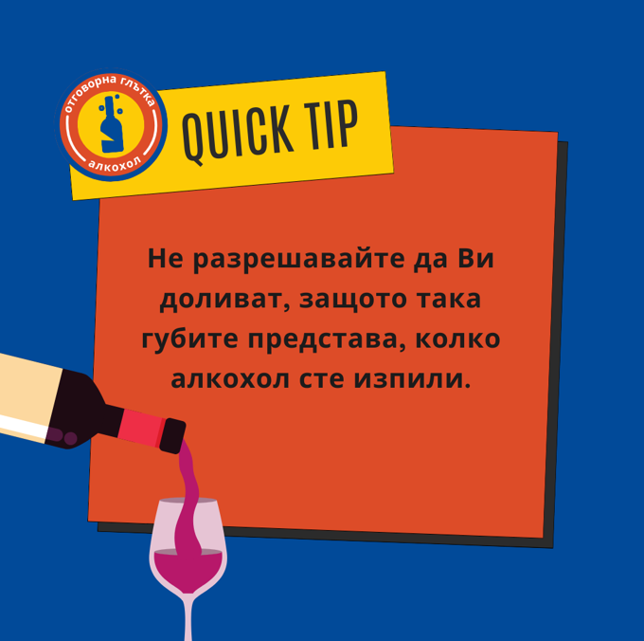
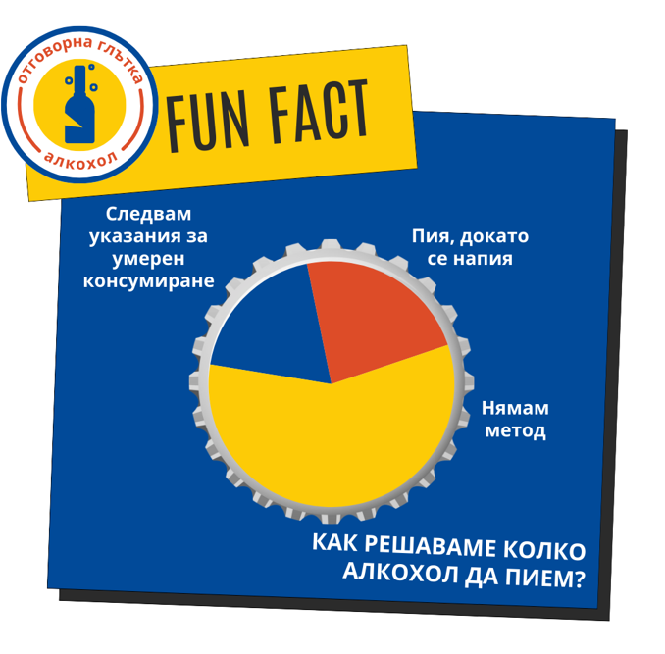



PROJECT 2: RESPONSIBLE SIP
Creators: Ana Lukanova and Yana Velinova, UNWE

Slide 20
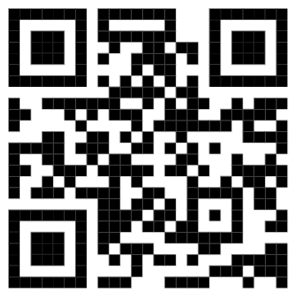
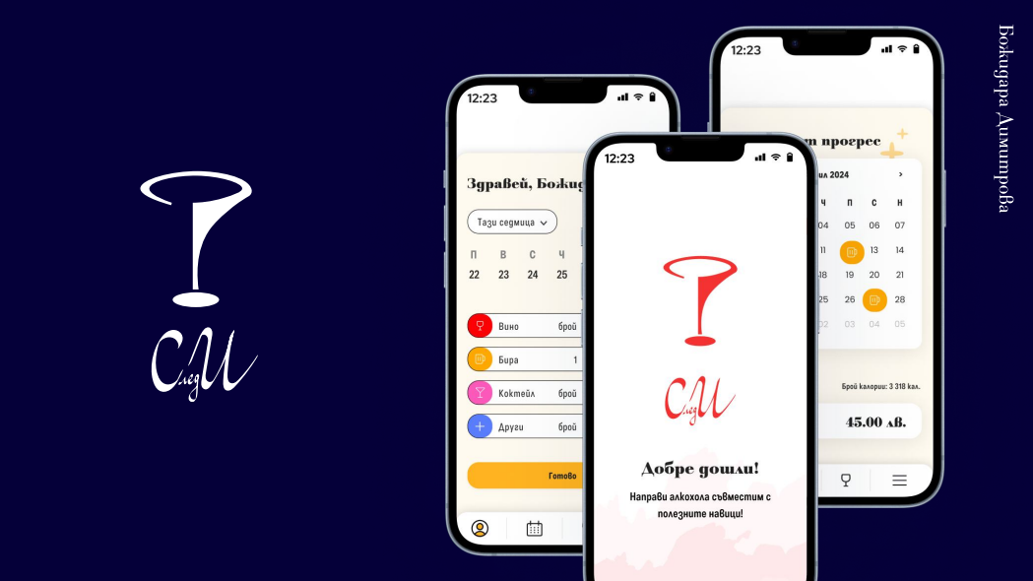
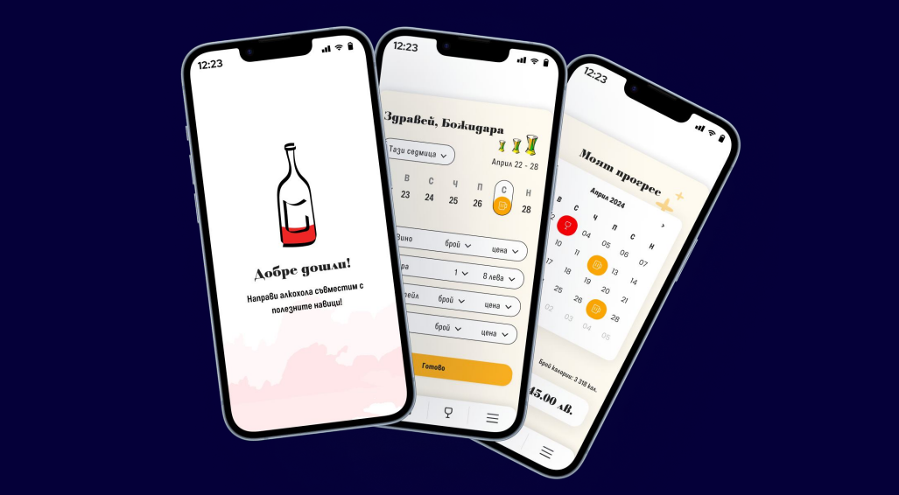
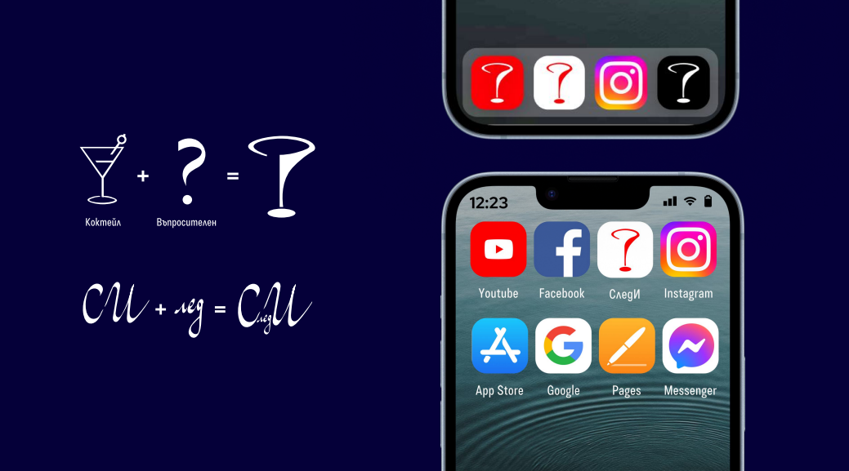
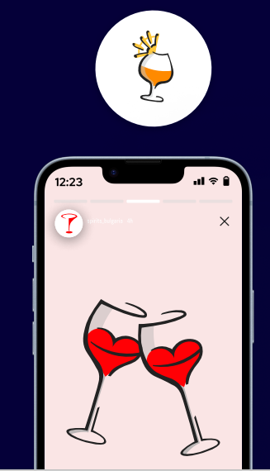
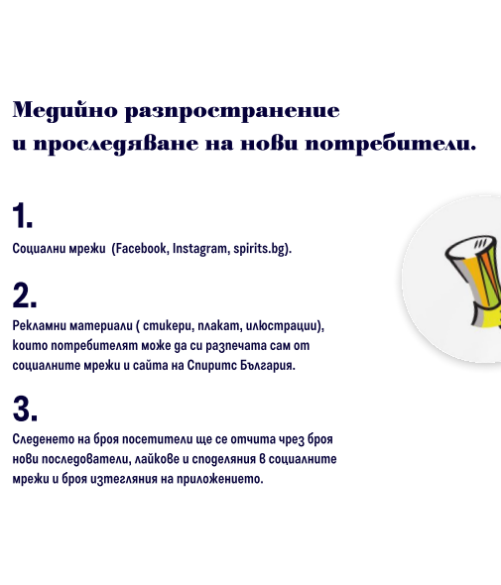
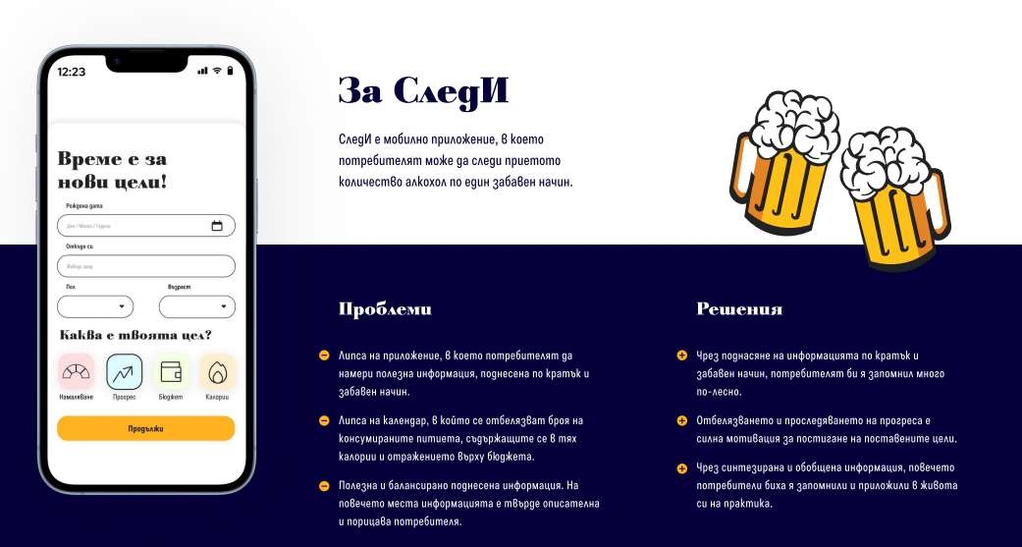
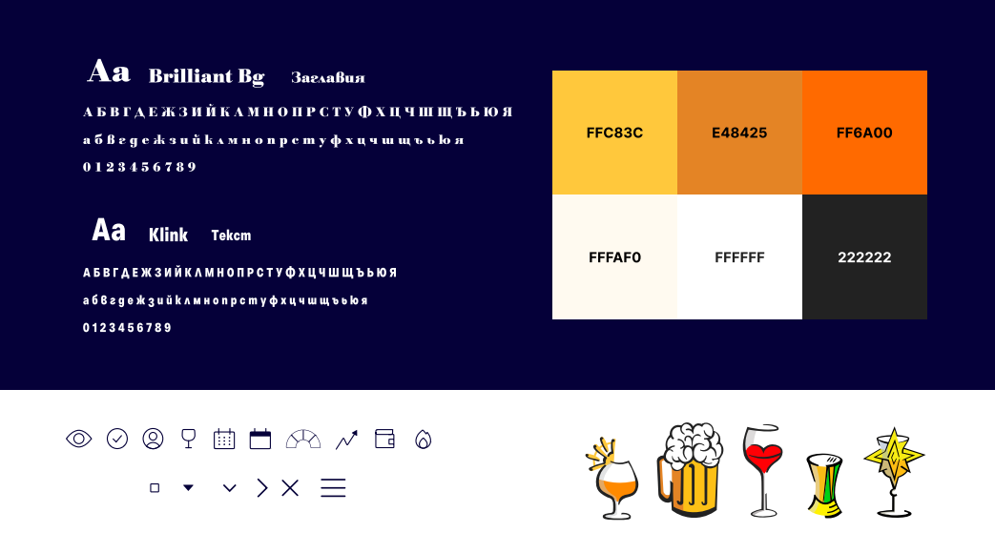
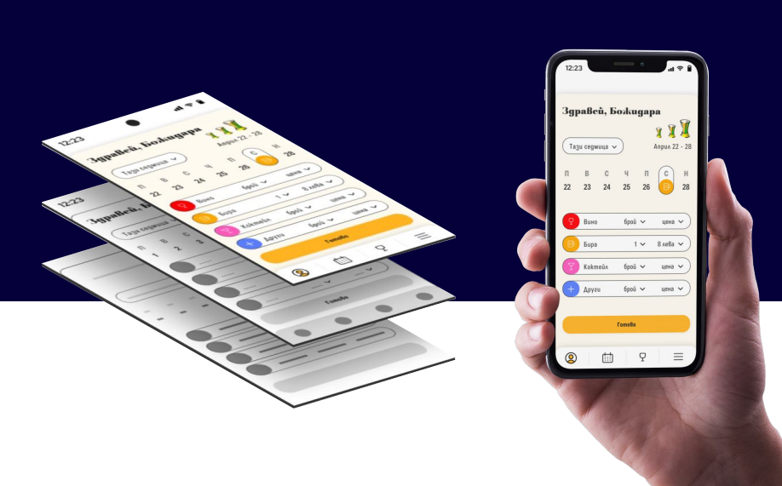
PROJECT 3: FOOTPRINT
Creator: Bozhidara Dimitrova, NAA

Slide 21
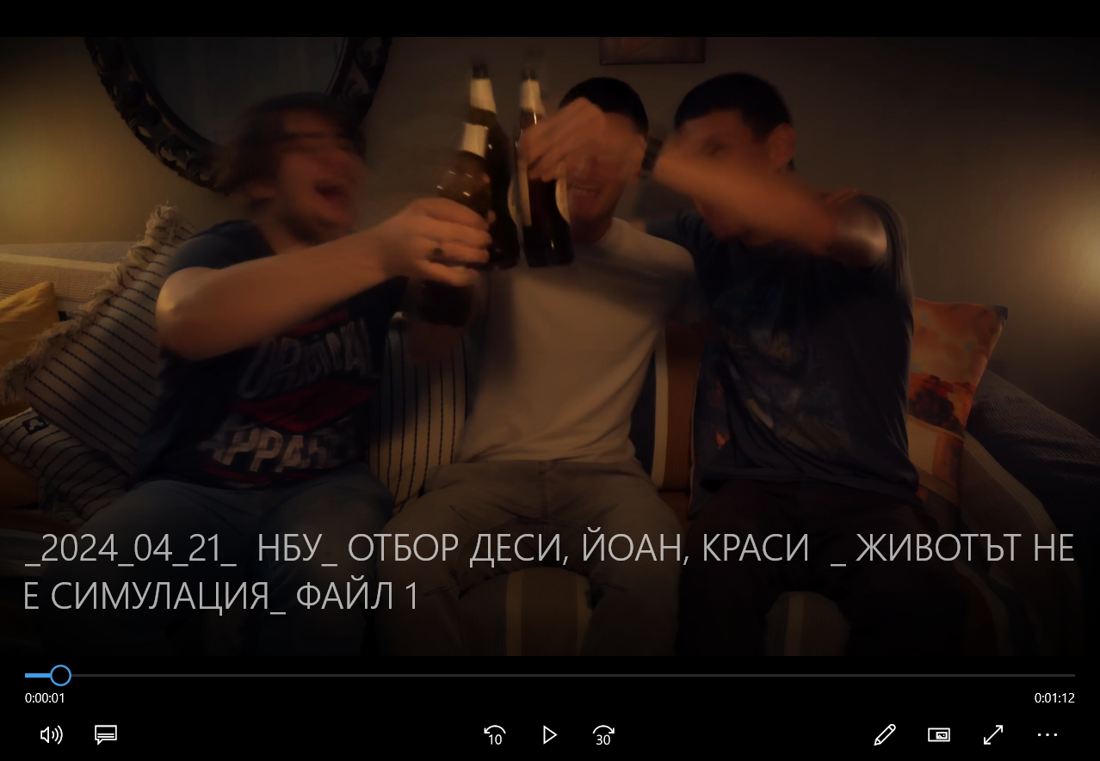
PROJECT 4: LIFE IS NOT A SIMULATION
Creators: Desislava Koleva, Ioan Kantarjiev and Krasimir Tutekov, NBU

Slide 22
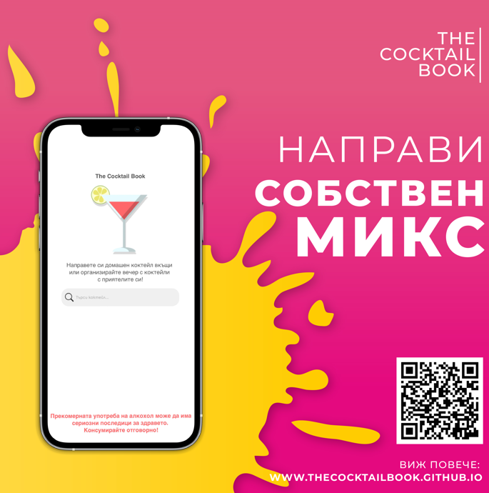
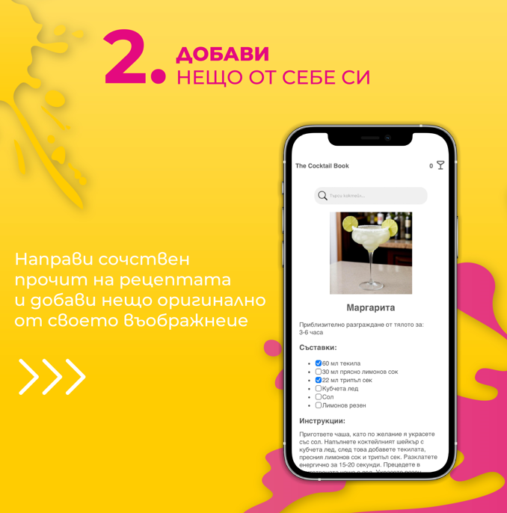

PROJECT 5: THE COCKTAIL BOOK
Creator: Emilia Angelova, NBU

Slide 23

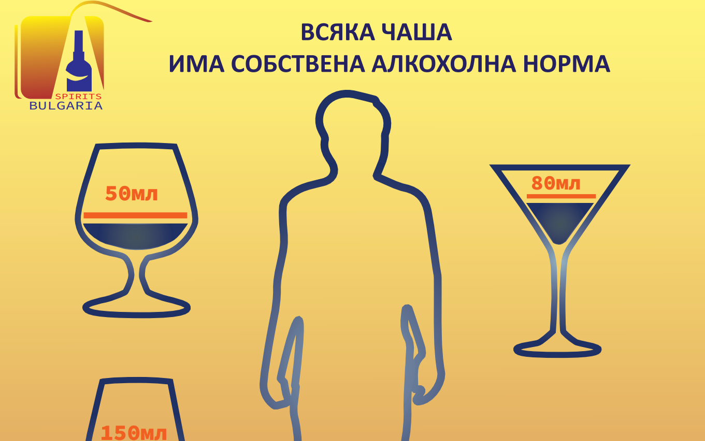
PROJECT 6: STAY LIGHT and YOU HAVE YOUR NORM
CREATOR: Inna Petrova, NAA

Slide 24
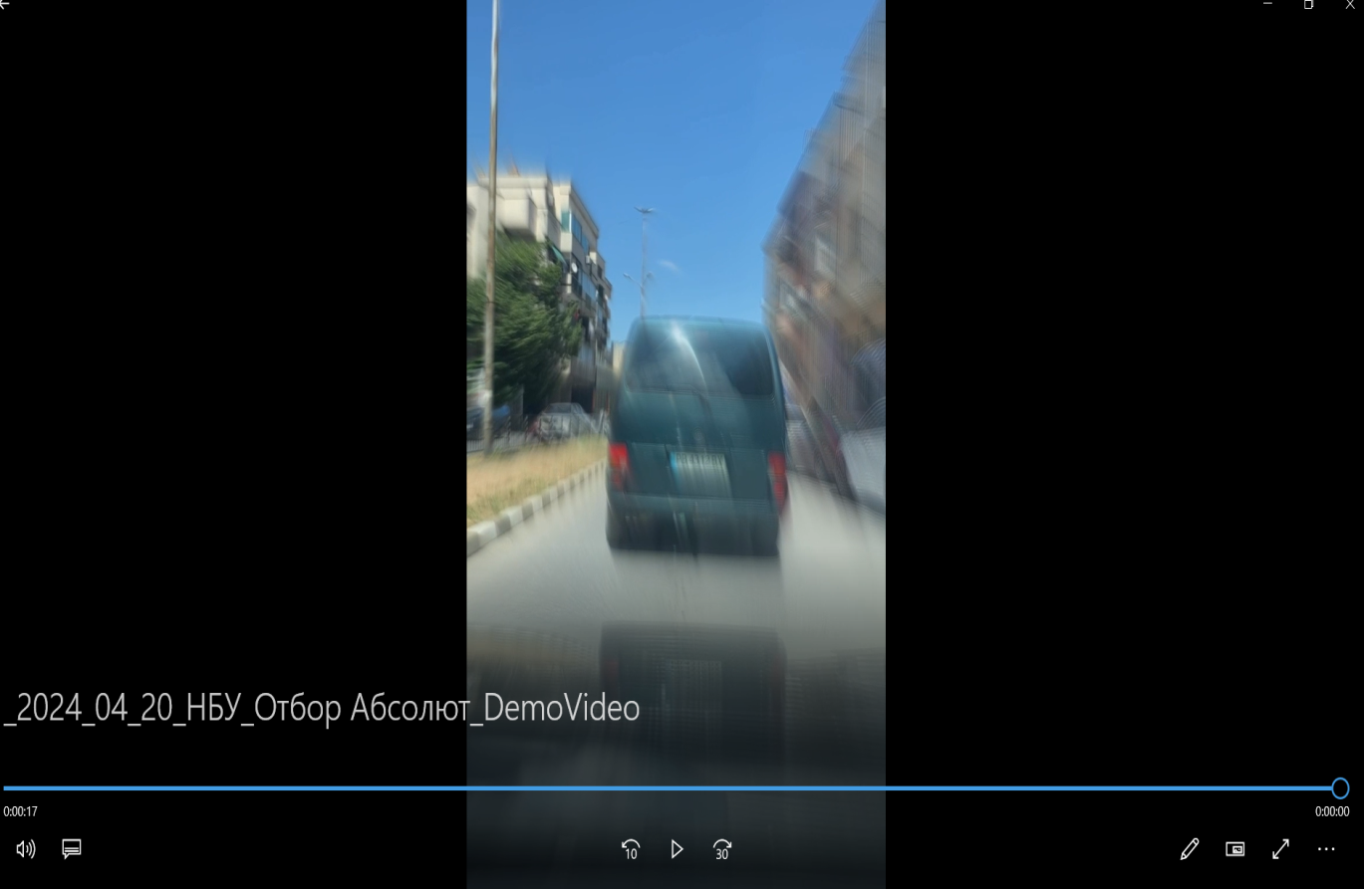

PROJECT 7: MORE OR LESS and I'M SICK
Creators: Absolut team, NBU (E. Dimcheva, Ya. Tolev, I. Minchev and D. Ivanov)

Slide 25
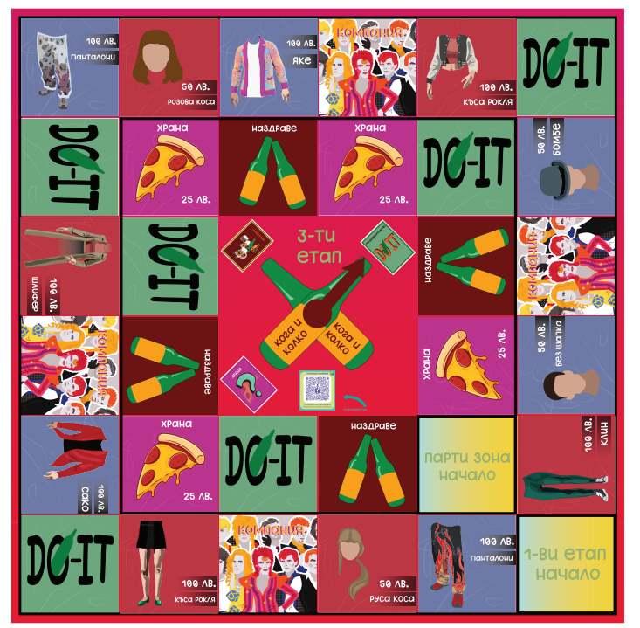
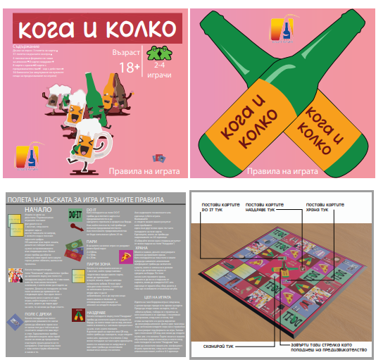
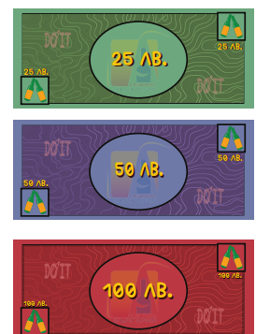
PROJECT 8: ONE FUN EVENING
Creator: Konstantin Petkov, NAA

Slide 26

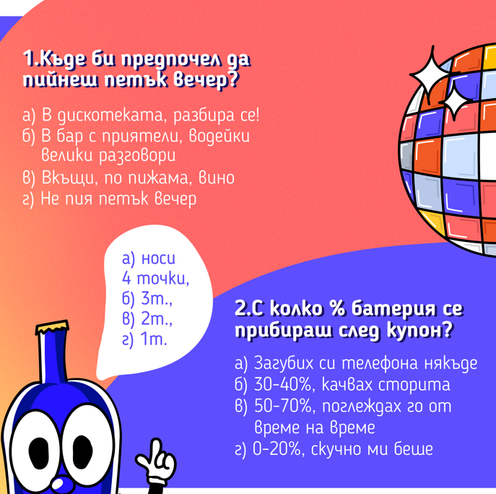
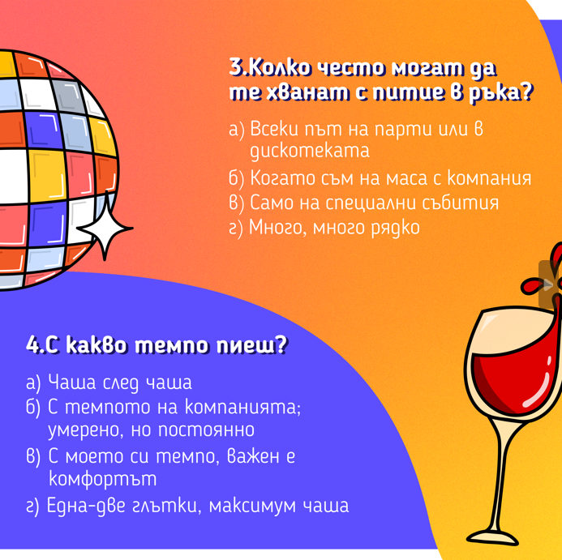

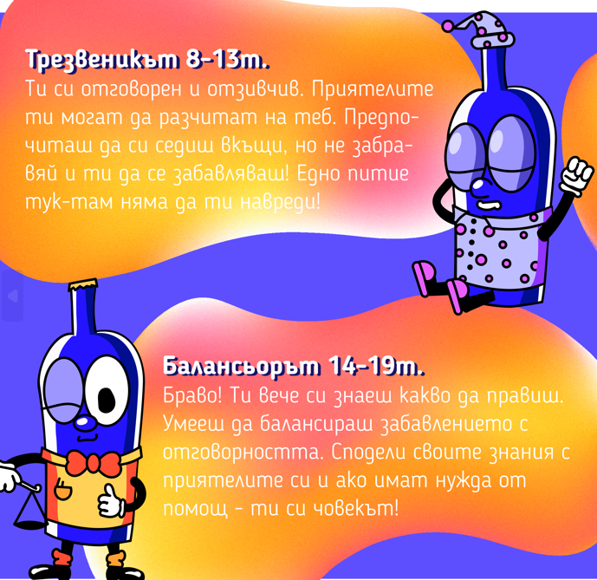
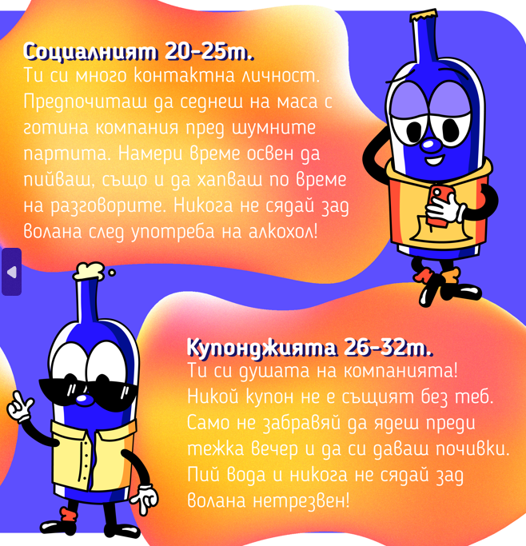
PROJECT 9: THE SCALE OF PERMISSION
Creators: Irina Oreshkova, Mirela Slavova and Magdalena Omajska, NBU

Slide 27
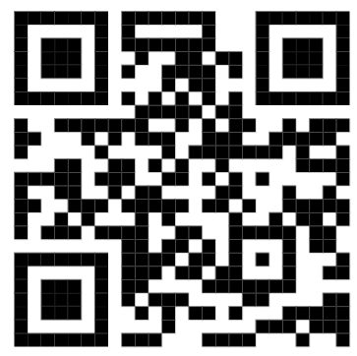
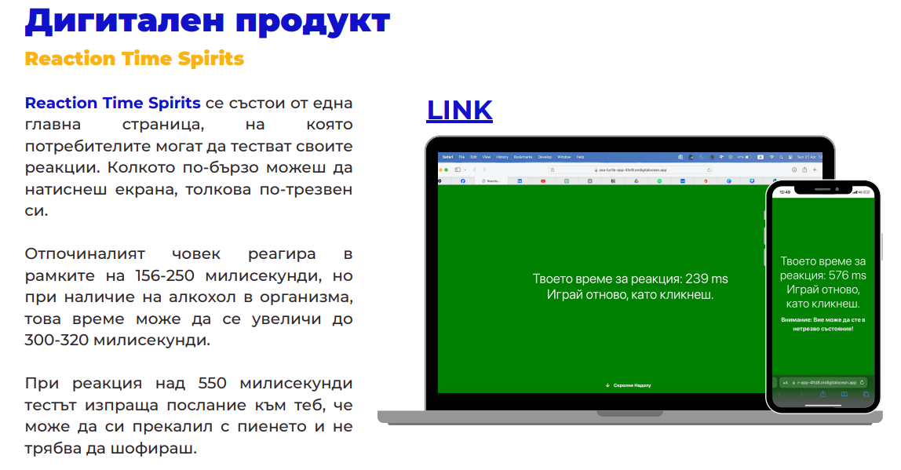
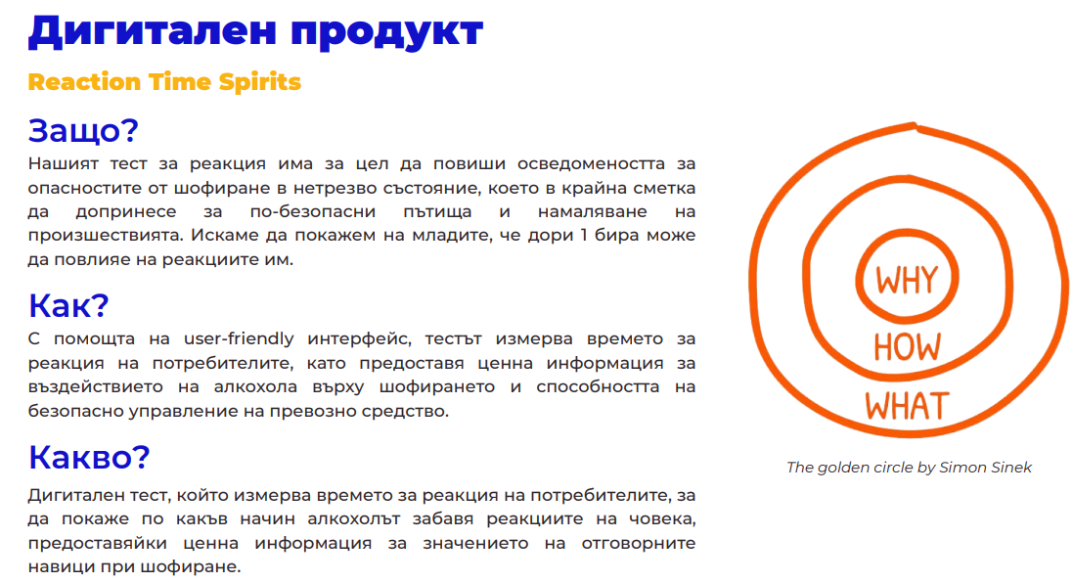
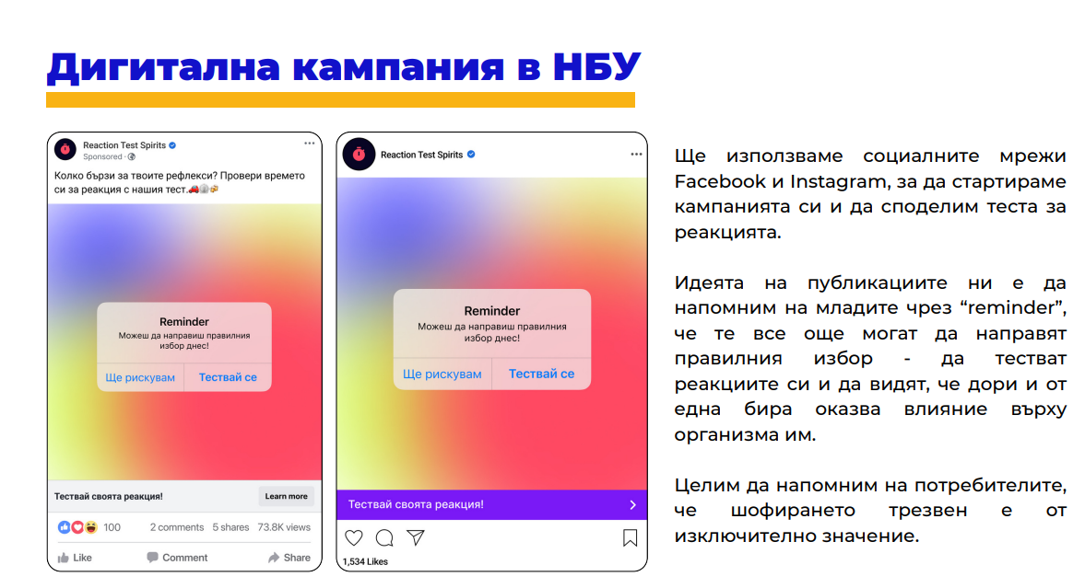

PROJECT 10: REACTION TIME SPIRITS
Creators: Banana Joes team, NBU: Christian Kostadinov and Raya Panayotova

Slide 28



PROJECT 11: THE BOTTLE IS A LOT!
Creator: Emilia Mladenova, UNWE

Slide 29







PROJECT 12: (HOW) WHAT WILL YOU DRINK? - 2nd PLACE
Creators: Izabela Dankova and Lora Tsvetkova, UNWE

Slide 30




PROJECT 13: CHEERS TO RESPONSIBLE NIGHTS!
Creators: Nazdravé team, UNWE (G. Dyakova, R. Semova, M. Antonova and L. Kiryanska)

Slide 31


PROJECT 14: SAVE THE MOMENT! – 3rd PLACE
Creators: Christiana Nocheva and Stoyana Peneva, NBU

Slide 32




PROJECT 15: WE&DRINKS
Creators: Vesela Saulska, Gabriela Kostadinova, Daniel Vassilev and
Zhaneta Sabeva, UNWE

Slide 33

PROJECT 16: AFTER A BOTTLE OF WINE
Creators: Vanessa Ivanova and Denis Traichev, NBU

Slide 34




PROJECT 17: SCREENSHOT – 1ST PLACE
Creators: Varti Mavreva and Gertana Dimitrova, NBU

Slide 35

PROGRAM ACHIEVEMENTS – THE AWARD CEREMONY

Slide 36







PROGRAM ACHIEVEMENTS – THE AWARD CEREMONY

Slide 37


PROGRAM ACHIEVEMENTS – THE AWARD CEREMONY

Slide 38


PROGRAM ACHIEVEMENTS – THE PUBLIC COVERAGE
https://vipbg.site/spiritsbalgariya/?fbclid=IwZXh0bgNhZW0CMTAAAR3ovUowWENJEwbvpebWm8SvIBabh08HHZhRn_qwoGgFoDzolgSwq5OosLY_aem_AdKOQ72gTZ0DurTpxh6H0fK7sLpQODaIMjRHQ7_vQqLUN79jz3ESBPwj9T1KhhJ48rSJbCK05JksJYewBgy96MvA
https://www.unwe.bg/bg/news/30439/%d0%b4%d0%b2%d0%b0-%d0%be%d1%82%d0%b1%d0%be%d1%80%d0%b0-%d0%bd%d0%b0-%d0%bd%d0%b0%d1%88%d0%b8%d1%8f-%d1%83%d0%bd%d0%b8%d0%b2%d0%b5%d1%80%d1%81%d0%b8%d1%82%d0%b5%d1%82-%d1%81%d0%bf%d0%b5%d1%87%d0%b5%d0%bb%d0%b8%d1%85%d0%b0-%d0%bd%d0%b0%d0%b3%d1%80%d0%b0%d0%b4%d0%b8-%d0%b2-%d0%ba%d0%be%d0%bd%d0%ba%d1%83%d1%80%d1%81-%d0%b7%d0%b0-%d0%b4%d0%b8%d0%b3%d0%b8%d1%82%d0%b0%d0%bb%d0%bd%d0%b0-%d0%ba%d0%b0%d0%bc%d0%bf%d0%b0%d0%bd%d0%b8.html

Slide 39



PROGRAM ACHIEVEMENTS – THE PUBLIC COVERAGE
https://www.facebook.com/100064354556956/posts/834585508696593/?mibextid=WC7FNe&rdid=JAWQdxFNrAjvsXez

Slide 40


PROGRAM ACHIEVEMENTS – THE PUBLIC COVERAGE

Slide 41



PROGRAM ACHIEVEMENTS – THE PUBLIC COVERAGE
In INSTAGRAM

Slide 42

PROGRAM ACHIEVEMENTS – CLOSE AND FOLLOW UP
ROADPOL SAFETY DAYS LEAFLET 2024
Target reach to 100 000 young rivers
QR codes of winning RD students’ projects are printed on the back of the flyer

Slide 43

Pernod-Ricard Bulgaria
Web site PR новина, която да отразява конкурса, проведен от Спиритс България и печелившия проект;
Newsletter - PR новина, който да препраща към статията в сайта;
2 броя пост вън Фейсбук:
Печелившия продукт, с таргет аудитория 25-65г, Facebook;
Печелившия продукт и статията, Насочен към аудитория 18-25г, dark post, Facebook
Планът на кампанията е един месец – до края на юли.

Slide 44
PROGRAM ACHIEVEMENTS – NEXT STEPS
2024
  Online advertising of the winning project to increase reach and CPT, funded by spiritsBULGARIA member Pernod-Ricard Bulgaria (results will be added to this report when available)
  Assign winners to be Ambassadors of responsible consumption and gather them once a year
2025
  Negotiations for partnership of the program with all universities having digital art curriculums
  Split contest categories to digital, video, print, etc.
  Request QR code for each project
  Entering into European competition with Bulgarian national winning projects

Slide 45

HERE WE ARE!

Slide 46

FINAL CONCLUSION
RESPONSIBILITY + CONSISTENCY
+ LOVE
=
FUTURE!
WE ARE IN THE FUTURE!
W
office@spirits.bg

