Slide 1
ROADPOL SAFETY DAYS 2024 Bulgaria
October 2024 Issued by spiritsBULGARIA

Slide 2
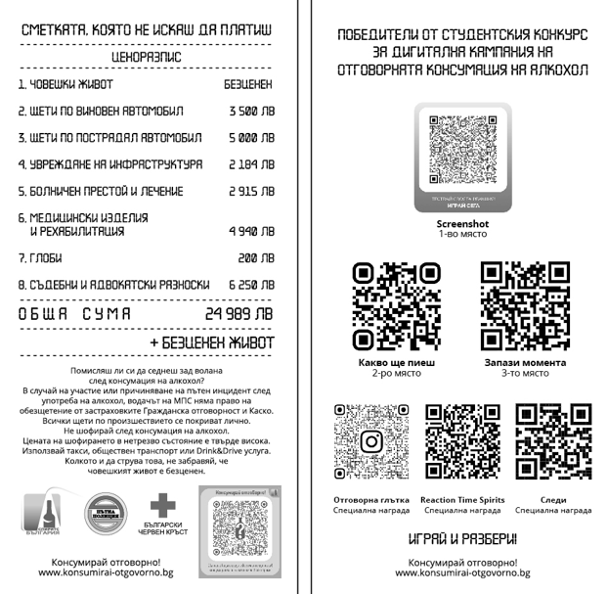
ROADPOL SAFETY DAYS FRAME
Partners
Directorate of Road Police of Bulgarian Ministry of Internal Affairs
Bulgarian Red Cross
T. Kableshkov, University of Transport
The Flyer
The bill you do not want to pay
100 000 pcs (vs 40 000 pcs in 2023) with
QR codes of all winning projects from the
student contest
Distributed by our partners
mainly young drivers and students

Slide 3
ROADPOL SAFETY DAYS FRAME
National Day of Road Safety
June 29, 2024; nationwide
Flyers distribution and TV interview
First Aid Courses for Novice Drivers
Ongoing; nationwide
Flyers giving to each new driver by the Red Cross at their first aid seminars
Roadpol Safety Week
September 16-22, 2024
Flyers distribution by Road Police officers
Contest for Best Road Police Officer
September 23, 2024; Panagjurishte town
Flyers distribution by the Red Cross
7Th National Conference for Road Strength and Safety
October 10, 2024
RD presentation and flyers distribution to students and Sofia technical secondary school graduate
Co-partner of presentation was the Directorate of Road Police of Bulgarian Ministry of Internal Affairs in the face of Deputy Chief Commissioner Maria Boteva

Slide 4
CALL FOR APPLICATION ACHIEVEMENTS vs TARGETS 2024
Targets to reach with leaflets
All universities where we do the students’ contest for digital advertising campaign of responsible drinking
More cities in Bulgaria through the assistance of Bulgarian Ministry of Internal Affairs
All relevant activities of Bulgarian Red Cross
Achievements
Leaflets were also distributed to all students at educational seminars of the RD digital contest (254 people)
Audience of educational seminar at Technical university “T. Kableshkov” was widen up with school graduates (36 people)
27 cities were approached through the volunteers of the Red Cross; Audience of new events included
The biggest achievement were leaflet distribution at first aid courses for novice drivers of the Red Cross

Slide 5
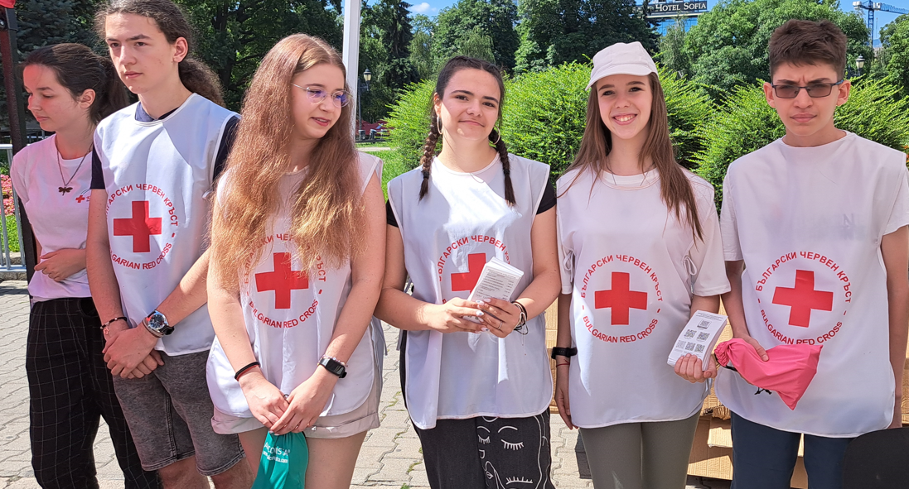
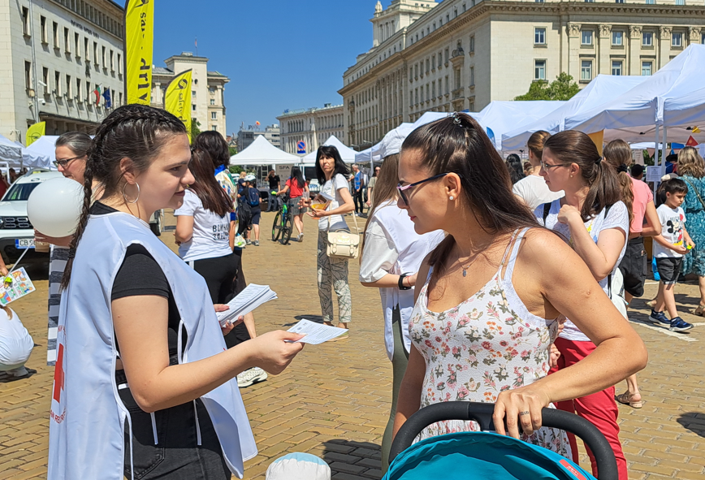
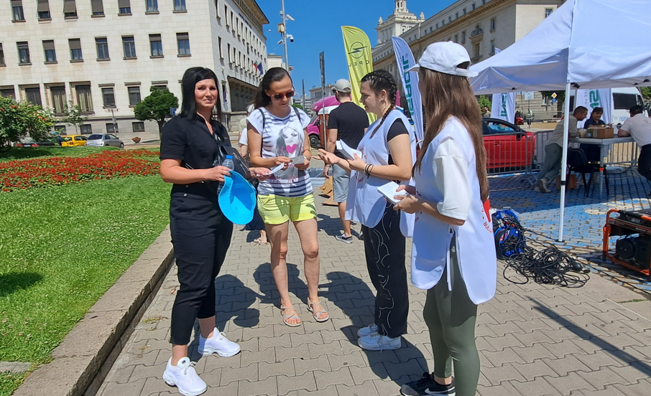
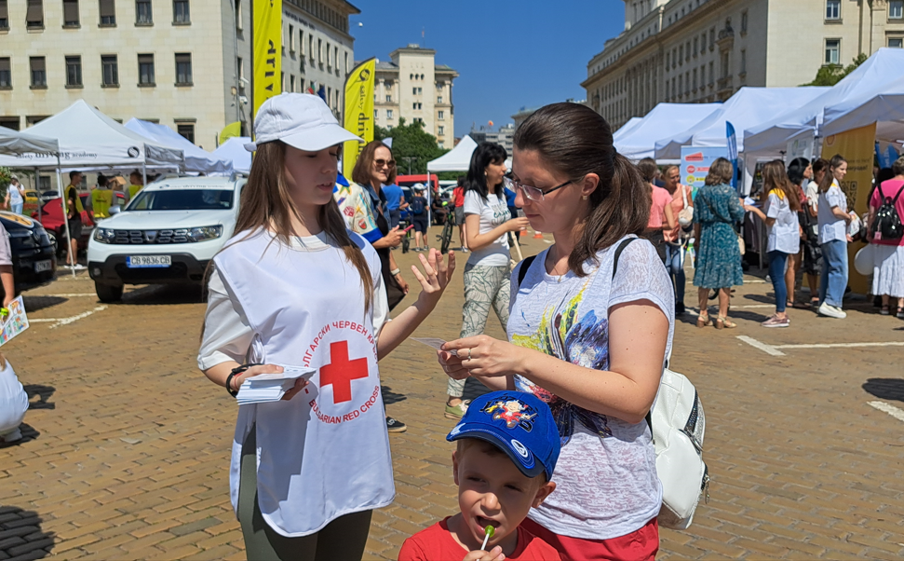
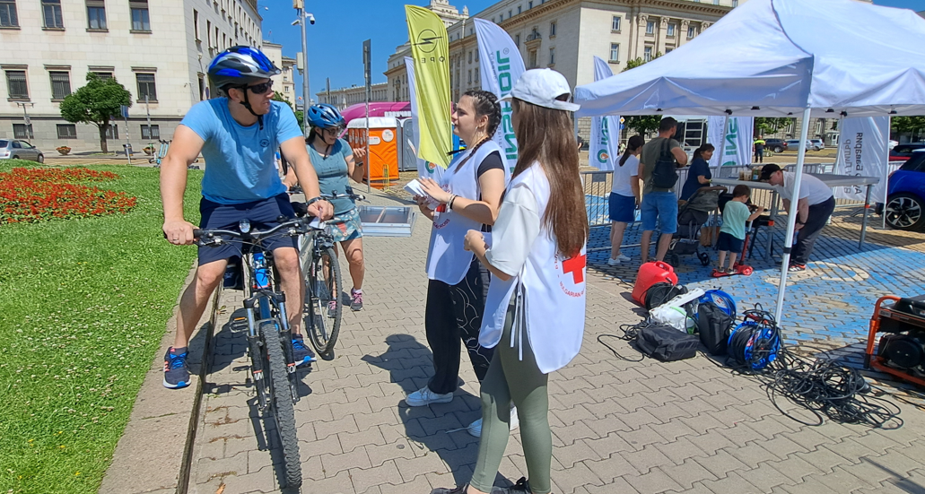
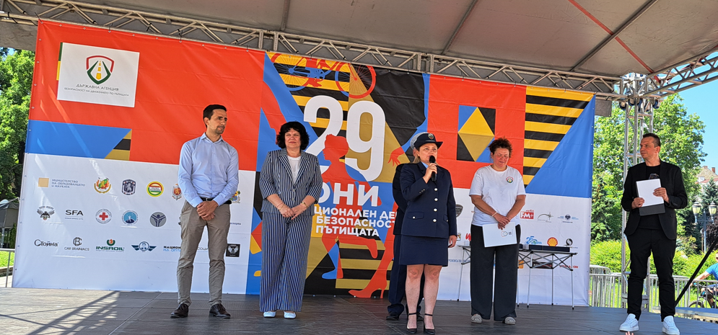
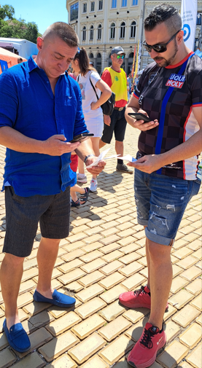
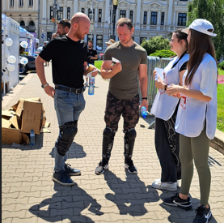
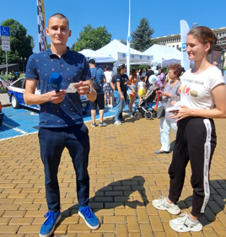
NATIONAL DAY OF ROAD SAFETY 2024

Slide 6
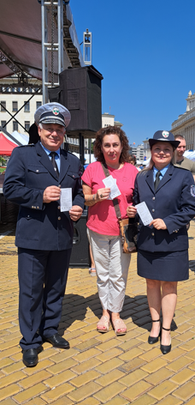
NATIONAL DAY OF ROAD SAFETY 2024 PUBLICITY
TV On-air interview - June 29, 2024
https://www.bgonair.bg/a/2-bulgaria/350195-otbelyazvame-natsionalniya-den-na-bezopasnostta-na-dvizhenieto-po-patishtata

Slide 7
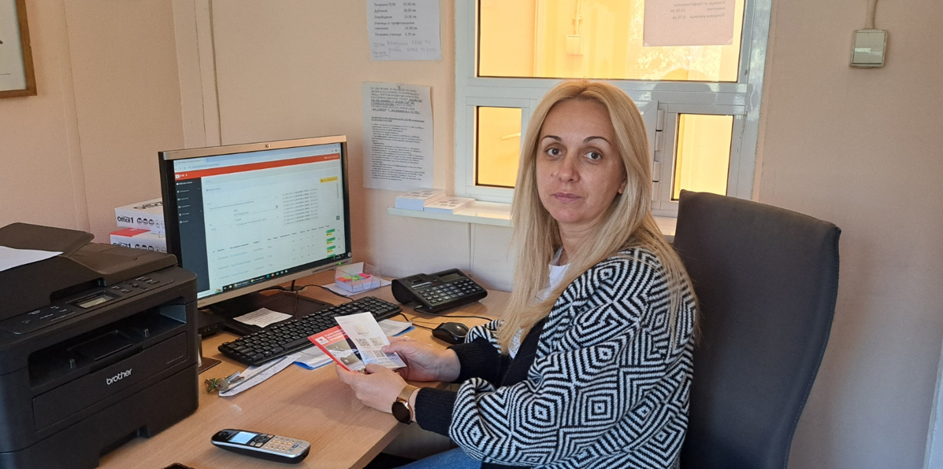
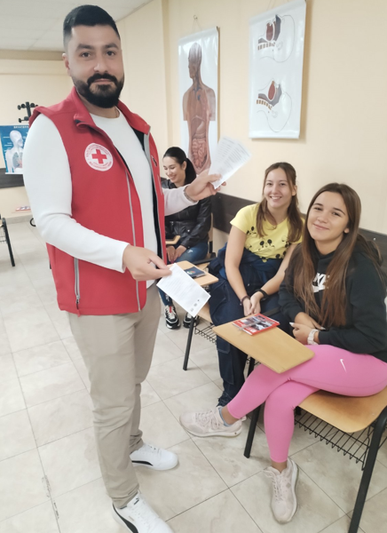
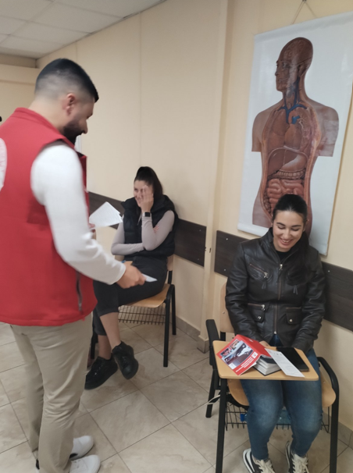
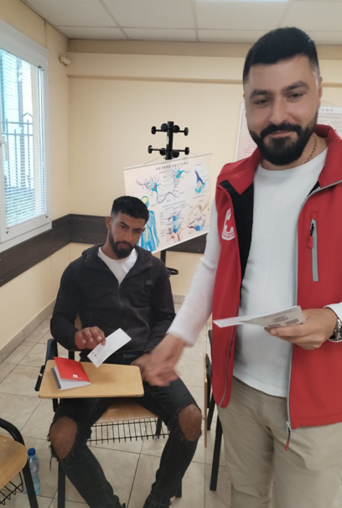
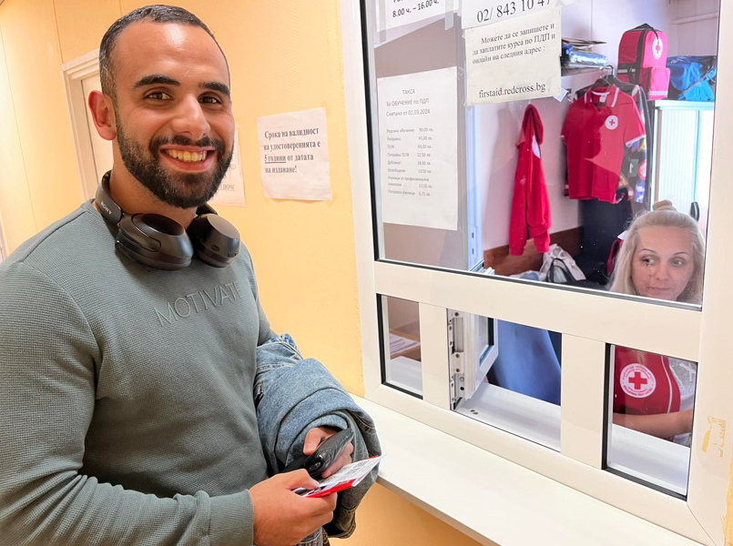
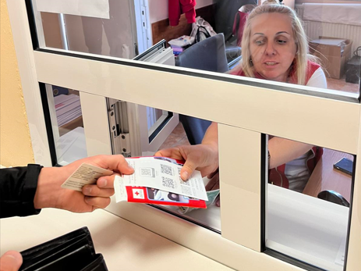
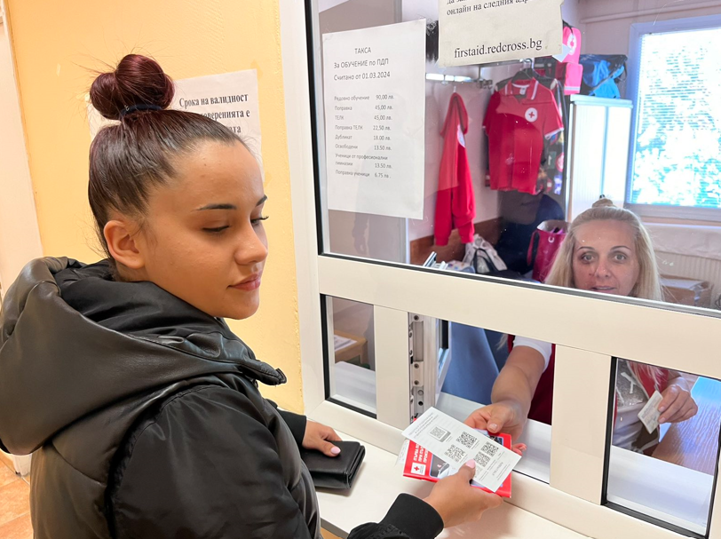
FIRST AID COURSES FOR NOVICE DRIVERS 2024

Slide 8
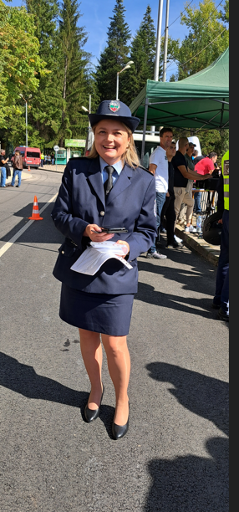
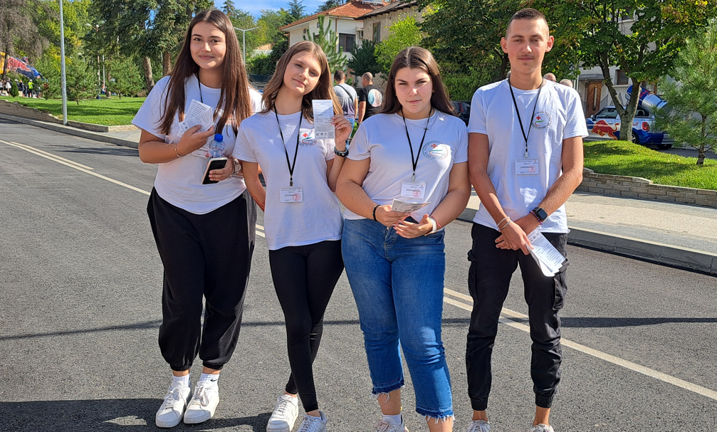
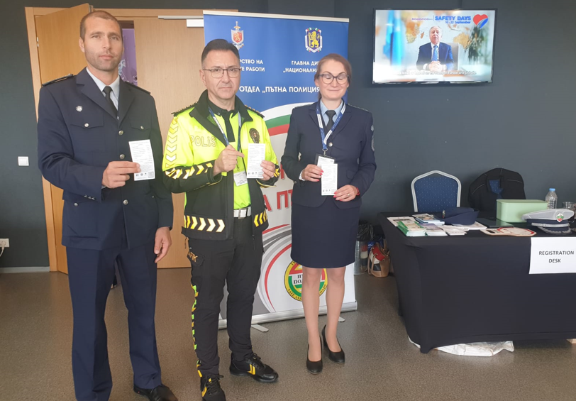
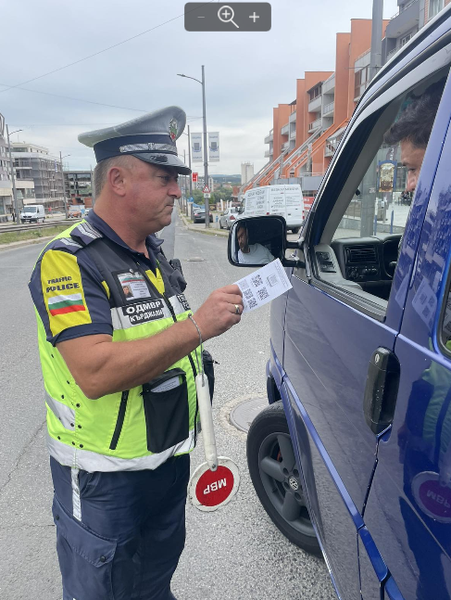
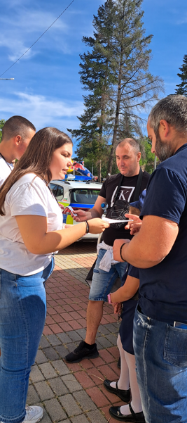
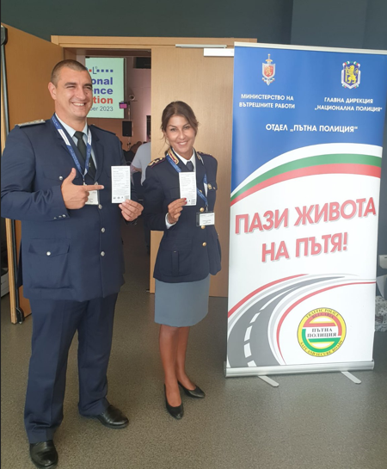
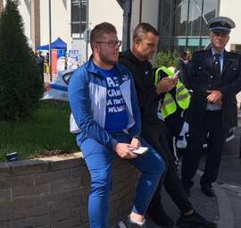
ROADPOL SAFETY WEEK 2024

Slide 9
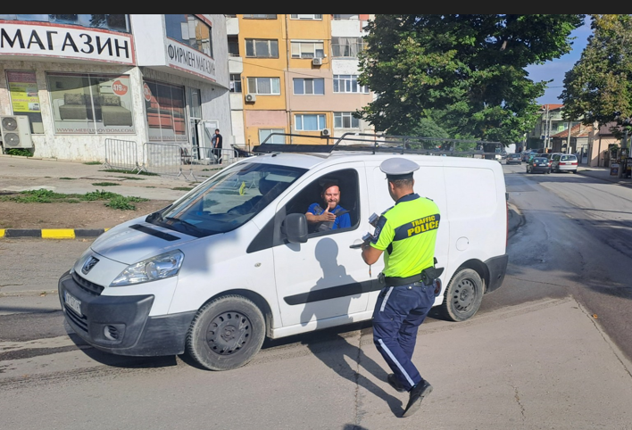
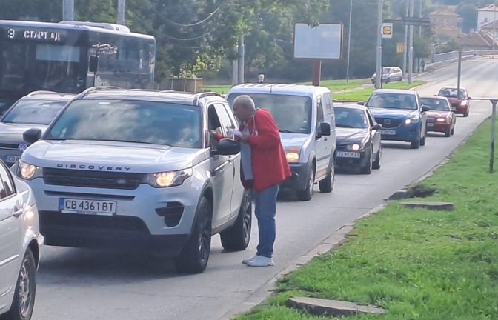
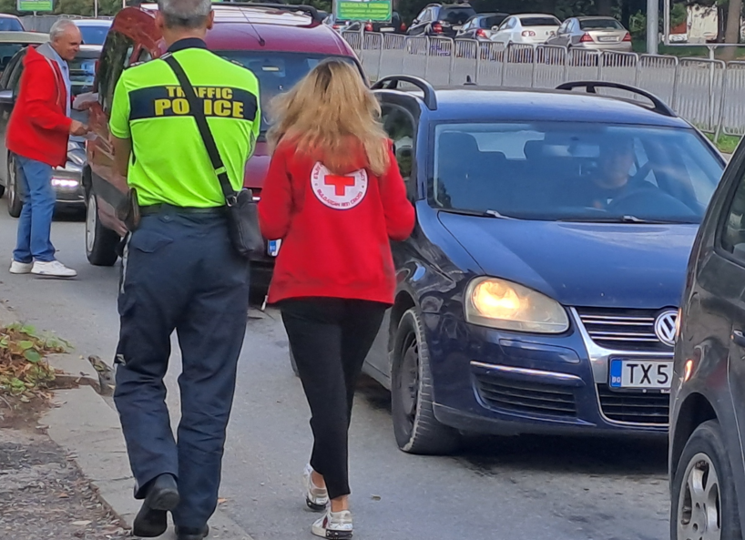
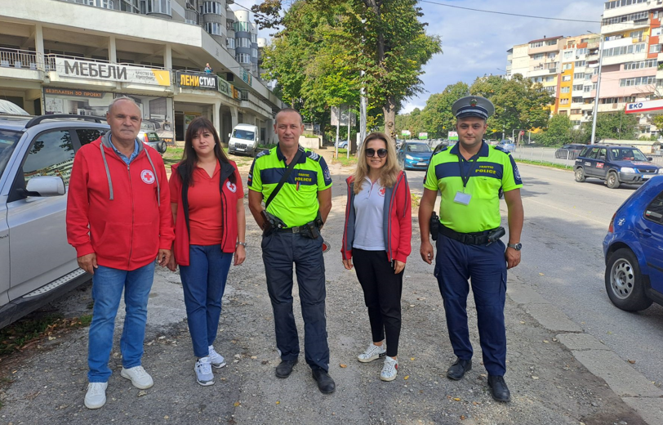
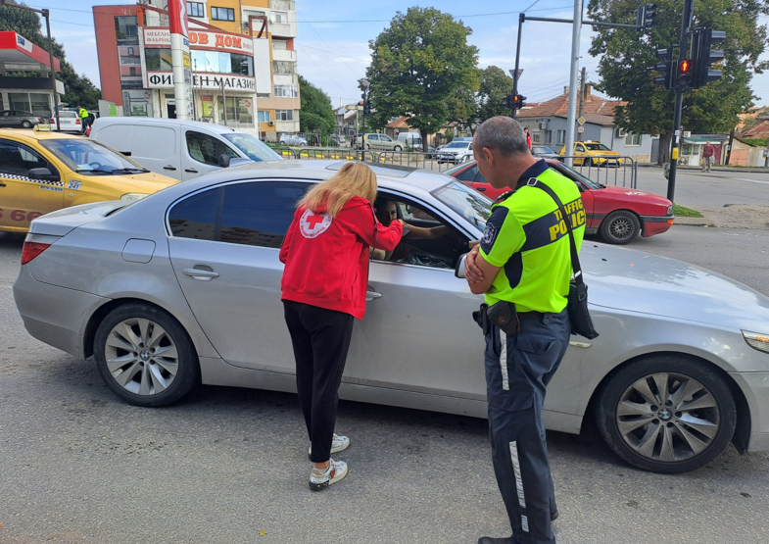
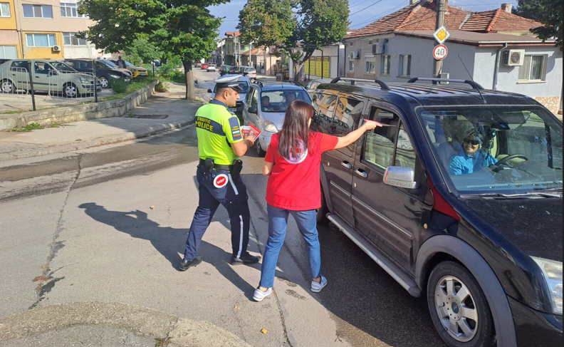
ROADPOL SAFETY WEEK 2024

Slide 10
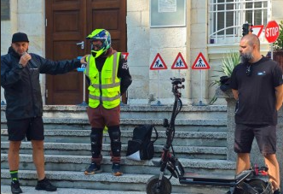
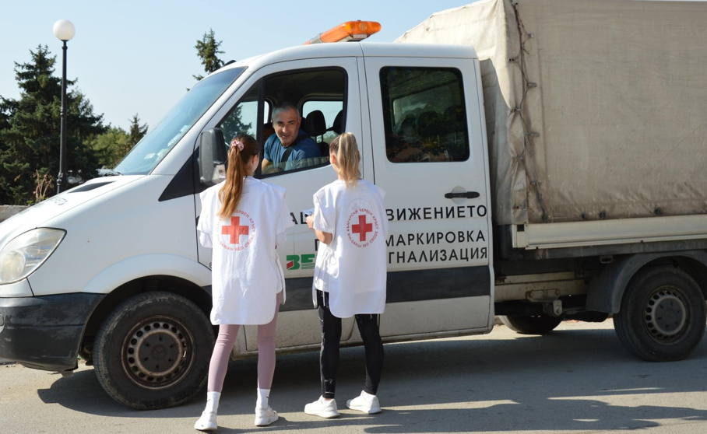
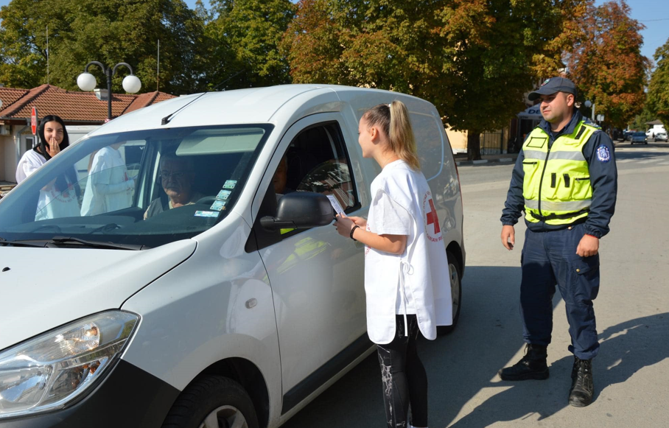
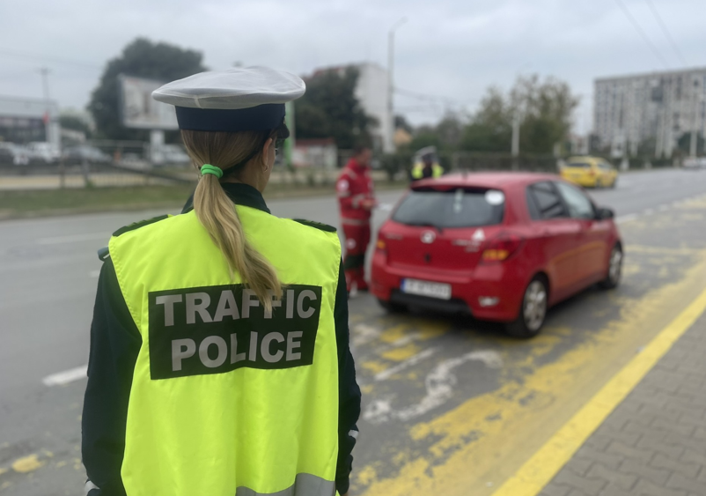
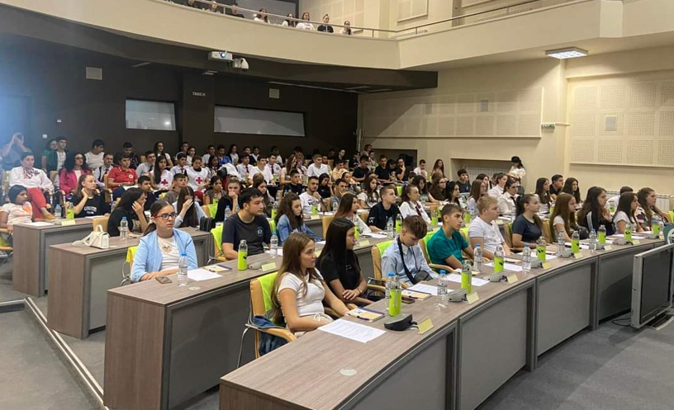
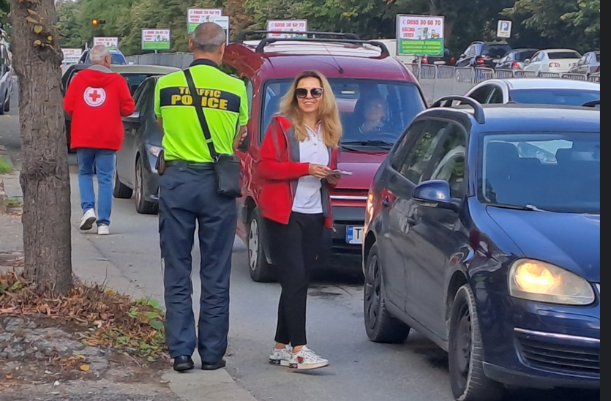
ROADPOL SAFETY WEEK 2024

Slide 11
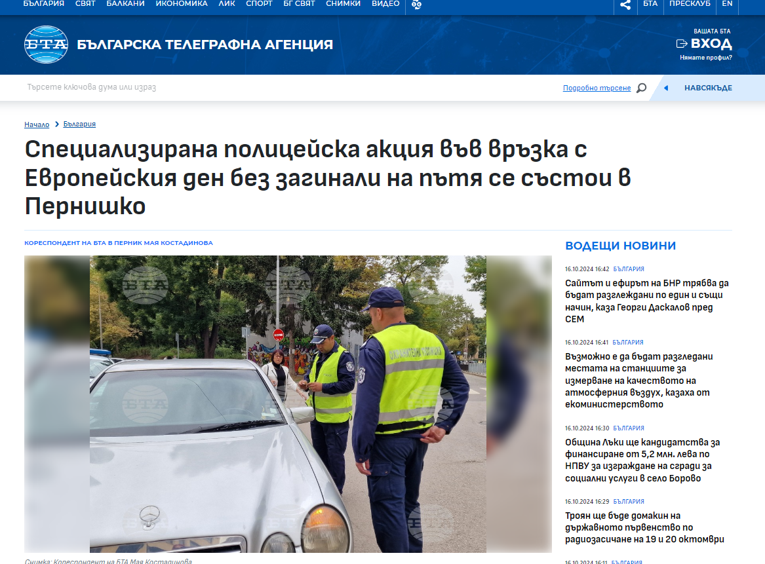
ROAD SAFETY WEEK 2024 PUBLICITY
A specialized police action in connection with the European Day without road deaths is taking place in Perniško, BTA, September 16, 20224
Road Safety Week September 16-22, 2024 has started, September 17, 20224

Slide 12
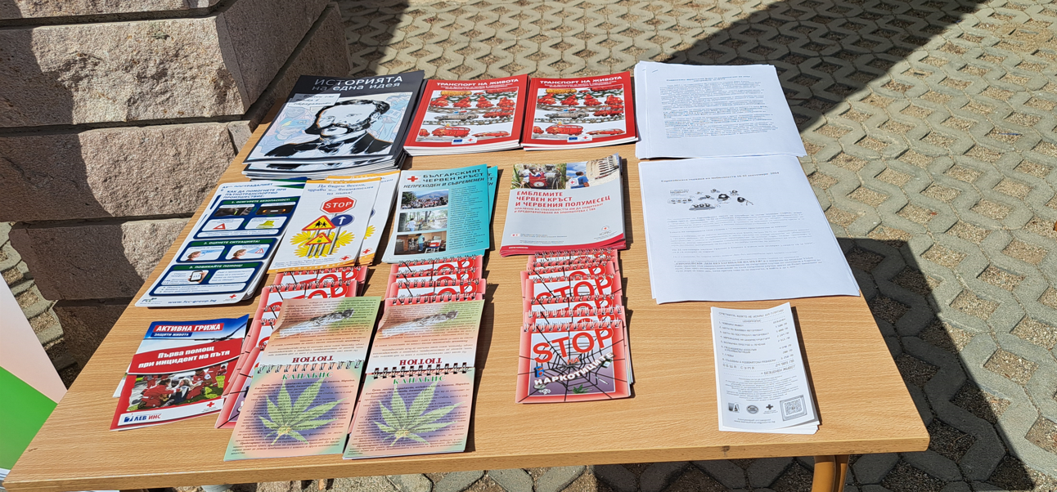
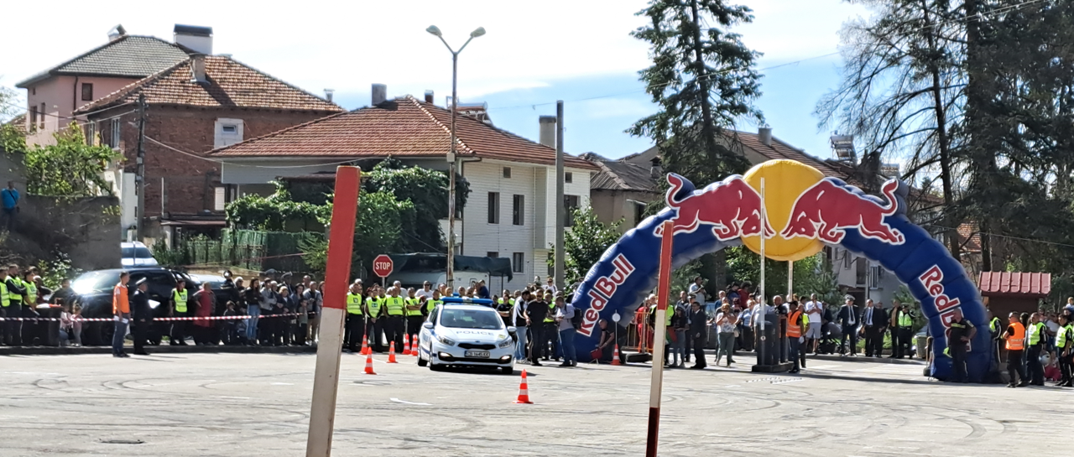
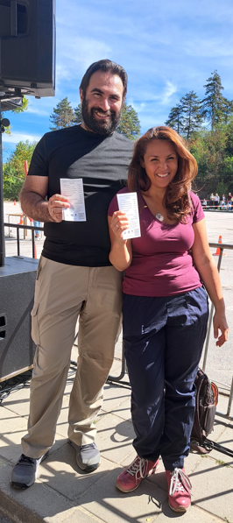
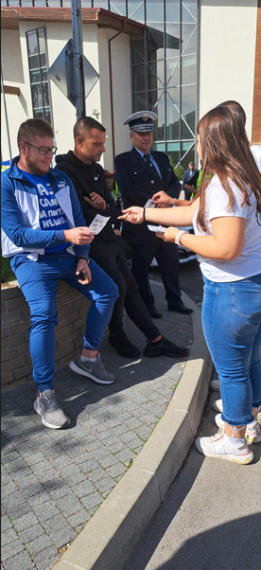
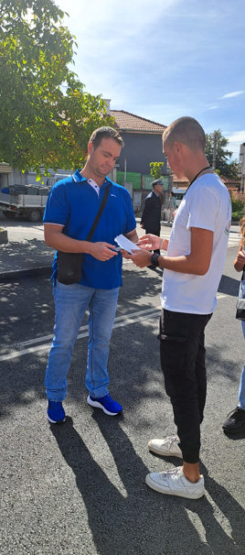
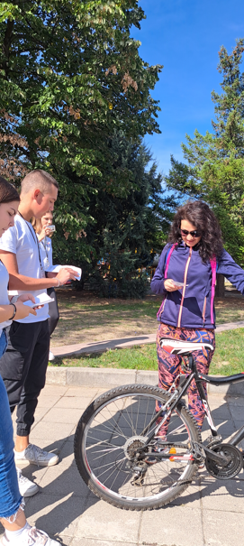
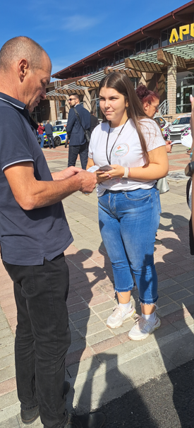
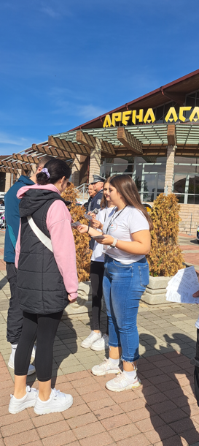
CONTEST FOR BEST ROAD SAFETY POLICE OFFICER 2024

Slide 13
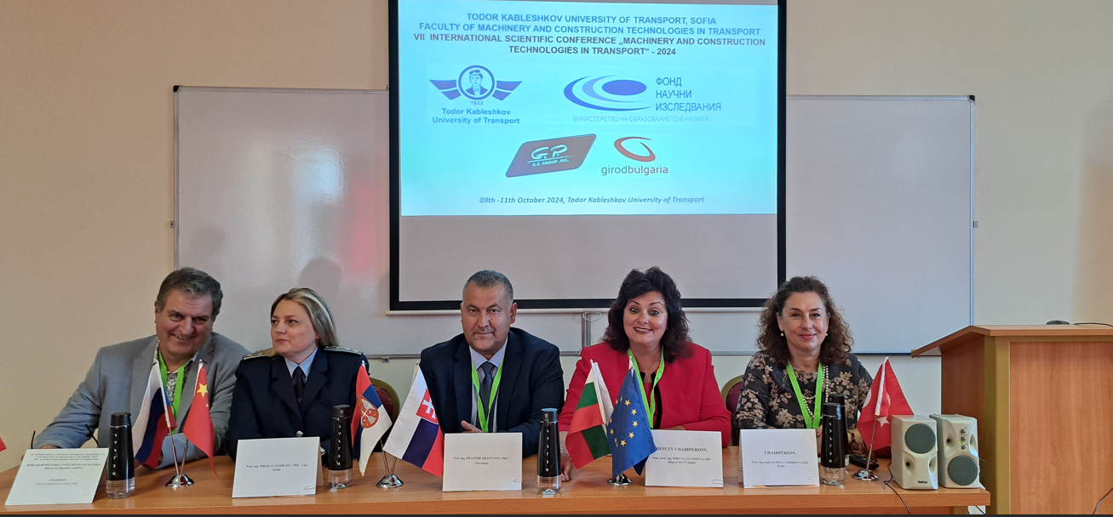
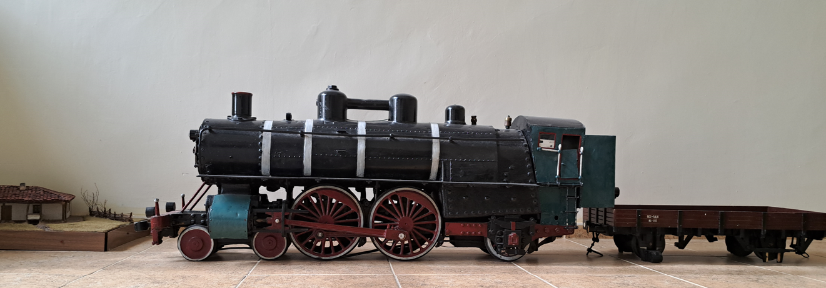
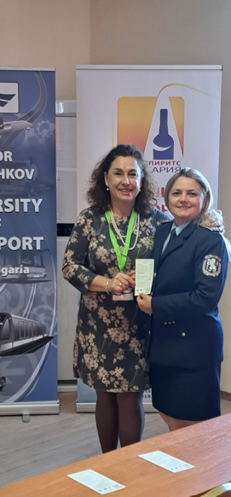
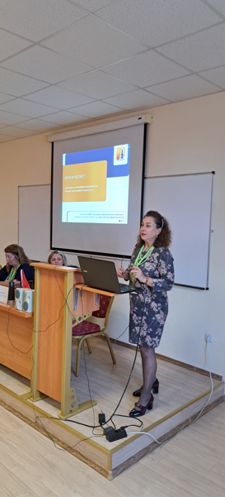
7Th NATIONAL CONFERENCE FOR ROAD STRENGTH AND SAFETY

Slide 14
7Th NATIONAL CONFERENCE FOR ROAD STRENGTH AND SAFETY PUBLICITY

Slide 15
THANK YOU FOR YOUR ATTENTION
office@spirits.bg

